Slide 1

Discrete Structures & Optimization
Mathematical Logic

Slide 2

Discrete Structures and Optimization
Mathematical Logic:
Propositional and Predicate Logic, Propositional Equivalences, Normal Forms, Predicates and Quantifiers, Nested Quantifiers, Rules of Inference.
Sets and Relations:
Set Operations, Representation and Properties of Relations, Equivalence Relations, Partially Ordering.
Counting, Mathematical Induction and Discrete Probability:
Basics of Counting, Pigeonhole Principle, Permutations and Combinations, Inclusion- Exclusion Principle, Mathematical Induction, Probability, Bayes’ Theorem .
Group Theory:
Groups, Subgroups, Semi Groups, Product and Quotients of Algebraic Structures, Isomorphism, Homomorphism, Automorphism, Rings, Integral Domains, Fields, Applications of Group Theory.
Graph Theory:
Simple Graph, Multigraph, Weighted Graph, Paths and Circuits, Shortest Paths in Weighted Graphs, Eulerian Paths and Circuits, Hamiltonian Paths and Circuits, Planner graph, Graph Coloring, Bipartite Graphs, Trees and Rooted Trees, Prefix Codes, Tree Traversals, Spanning Trees and Cut-Sets.
Boolean Algebra:
Boolean Functions and its Representation, Simplifications of Boolean Functions.
Optimization:
Linear Programming - Mathematical Model, Graphical Solution, Simplex and Dual Simplex Method, Sensitive Analysis; Integer Programming, Transportation and Assignment Models, PERT-CPM: Diagram Representation, Critical Path Calculations, Resource Levelling, Cost Consideration in Project Scheduling.

Slide 3
Introduction to Discrete Mathematics
Why study Discrete Mathematics?
To develop mathematical thinking.
To improve problem solving ability.
Foundation for other compute science subjects.
To solve problems such as:
  Sorting the list of integers,
  Finding shortest path between places,
  Drawing graphs without lifting the pen and without repeating edges,
  Message Encryption, etc…

Slide 4
Introduction to Discrete Mathematics
What is Discrete Mathematics?
The study of discrete objects.
Discrete means distinct or not connected.
A branch of mathematics dealing with
“Discrete but not continuous”

Slide 5
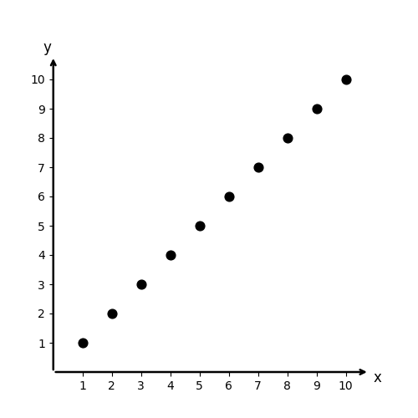
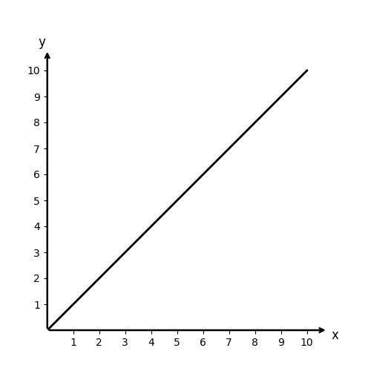
Introduction to Discrete Mathematics
Discrete vs Continuous
Discrete Objects | Continuous Objects
Natural numbers, N = 1, 2, 3, … Consider the graph for y=x where x,y belongs to N, gaps are present between points. | Real numbers, R between two numbers 0 and 1, there are infinite number of continuous points, 0.0001, 0.00001,... Consider the graph for y=x where x,y belongs to R, continuous line is plotted with no gaps in between.
Digital clock: No continuous time, sharp transition from one time to another time. | Analog clock: Hour, minute and second hands sweep smoothly over time.

Slide 6
Mathematical Logic
Propositional and Predicate Logic
Propositional Equivalences
Normal Forms
Predicates and Quantifiers
Nested Quantifiers
Rules of Inference

Slide 7
Introduction to Propositional Logic
What is Logic?
The science of reasoning.
To understand & reason about different mathematical statements.
Rules of logic enable to
  Think about mathematical statements,
  Prove or disprove mathematical statements precisely.
  Reason about mathematical statements.
“For every positive integer, the sum of positive integers not exceeding n is n(n+1)/2”.
Either it is a valid mathematical argument or it is an invalid argument.

Slide 8
Introduction to Propositional Logic
Purpose of Logic?
To construct valid arguments or proofs
Once we prove a mathematical statement is true, then we call it a Theorem.
Famous Knights and Knaves Puzzle:
In an Island there are two kinds of inhabitants, Knights, who always tell the truth, and their opposites, Knaves, who always lie. You encounter two people Alice and Bob. Who are Alice and Bob if Alice says “Bob is a Knight” and Bob says “The two of us are opposite types”?
These types of problems can be easily solved by an area of logic called propositional logic.

Slide 9
Propositional Logic
Which of the following is/are proposition(s). Also if you find the proposition, state whether it is True or False:
London is in Denmark.
Do your Homework.
India wins the match by 2 runs.
x is an even number.
5 is an odd number.
Rahul.
5 + 7 = 10
The moon is made of cheese.
The only odd prime number is 2.
God bless you!
What is proposition?
A declarative sentence that has a definite truth value.
A sentence that is declaring a fact or stating an argument which can be either TRUE or FALSE but cannot be both.
Atomic Propositions: A simple statement without logical connectives that cannot be broken down further.
Compound Propositions: A statement formed by combining atomic propositions using logical connectives like AND, OR, or NOT.
Non-Propositions: Questions, commands, and opinions with no definite truth value or may vary depending on context:
Delhi is the capital of India. ✅
Water froze this morning. ✅
1 + 1 = 2 ✅
What time is it? ❌
x + 1 = 2 ❌
Send us your resume before 11 PM. ❌
I request you to please allow me a day off. ❌
Fetch my umbrella! ❌
✅
F
❌
✅
T/F
❌
✅T
❌
✅F
✅
F
✅
F
❌

Slide 10
Propositional Logic
Sentential / Statement Logic
Branch of formal logic that deals with propositions: statements that are either true or false, and the logical relationships between them, using connectives like "and," "or," "not," and "if...then."
Area of logic that studies ways of joining and/or modifying propositions to form more complicated propositions.
Studies the logical relationships and properties derived from these combined/altered propositions.
Logical connectives are used to join two propositions.
Statement 1: Adam is good in playing football.
Statement 2: This time he is representing his college at national level.
Adam is good in playing football and this time he is representing his college at national level.
Modifying a statement using negatives.
I enjoy watching television.
It is not the case that I enjoy watching television.

Slide 11
Propositional Logic
Why compound propositions?
Most mathematical statements are constructed by combining one or more than one propositions.
Propositional Variables
NET December 2018
In mathematical logic, which of the following are statements ?
(i) There will be snow in January
(ii) What is the time now ?
(iii) Today is Sunday
(iv) You must study Discrete Mathematics.
i ➔ (iii) and (iv) ii ➔ (i) and (ii)
iii ➔ (i) and (iii) iv ➔ (ii) and (iv)
Variables that are used to represent propositions.
Adam is good in playing football and this time he is representing his college at national level.
p = Adam is good in playing football.
q = this time he is representing his college at national level.
p ∧ q means p and q
✅

Slide 12
Logical Operators
Logical connectives combine simple propositions into compound ones using a small set of connectives. Its truth value depends on the truth values of its parts across every possible scenario.
Truth table: compilation of all possible scenarios in tabular format.
Negation
Conjunction
Disjunction
Exclusive OR
Implication
Biconditional
Negation
Let p be a proposition.
¬p is called negation of p which simply states that
"It is not the case that p" .
if p is true then ¬p is false.
if p is false then ¬p is true.
p: "Adam and Eve lived together for many years."
¬p: "It is not the case that Adam and Eve lived together for many years."
or
¬p: "Adam and Eve haven't lived together for many years."
p | ¬p
T | F
F | T

Slide 13
Logical Operators
p | q | p ∧ q
T | T | T
T | F | F
F | T | F
F | F | F
Conjunction
Let p and q be two propositions.
When both p and q are true, then p ∧ q is true.
‘and’ or ‘but’
12 is divisible by 3 and 3 is a prime number. (T)
Disjunction
p | q | p ∨ q
T | T | T
T | F | T
F | T | T
F | F | F
When both p and q are false, then p ∨ q is false.
16 - 4 = 10 or 4 is an even number. (T)
In order to get a job in this multinational company, experience with C++ or Java is mandatory.
Inclusive OR: Either p or q or both (p as well as q).

Slide 14
Logical Operators
Exclusive OR
Let p and q be two propositions.
Exactly one of p and q will be true but both cannot be true.
Exudes the both possibility.
When you buy a car from XYZ company, you get $2500 cashback or accessories worth $2500.
p: you get $2500 cashback.
q: you get accessories worth $2500
p ⊕ q: Either p or q but not both.
p | q | p ⊕ q
T | T | F
T | F | T
F | T | T
F | F | F
Coffee or Tea comes with dinner.
You can pay using US dollars or euros.
Dinner for two includes two items from column A or three items from column B.
A password must have at least three digits or be at least eight characters long.
To take discrete mathematics, you must have taken calculus or a course in CS.
XOR
XOR
XOR
OR
OR

Slide 15
Logical Operators
p | q | p → q
T | T | T
T | F | F
F | T | T
F | F | T
Implication
Also known as Conditional statement.
p → q: If p then q.
p is called the hypothesis or antecedent or premise.
q is called the conclusion or consequence.
Does not guarantee anything when the premise p is false.
There is no way of knowing whether or not the implication is false since p did not happen.
This situation is similar to the "Innocent until proven Guilty" stance, which means that the implication p→q is considered true until proven false.

Slide 16
Logical Operators
Implication
Example 1: "If you try hard for your exam, then you will succeed".
p = you tried hard for your exam. q = you succeed
Case 1: "You tried hard for your exam" and "you succeed"
p = True q = True p → q is True
Case 2: "You tried hard for your exam" but "you failed"
p = True q = False p → q is False
Case 3: "You haven't tried hard for your exam" and "You succeeded"
p = False q = True p → q is True
Case 4: "You haven't tried hard for your exam" and "You failed"
p = False q = False p → q is True.
If p itself is not satisfied then compound proposition cannot be False.
Not False means True.
If p is false then it doesn't matter what will be the truth value of q, p → q is always true.
If 1 + 1 = 3, then dogs can fly.✅
If 1 + 1 = 2, then dogs can fly.❌
If monkeys can fly, then 1 + 1 =3✅
If 1 + 1 = 2, then 2 + 2 = 5.❌
If Delhi is the capital of India then Beijing is the capital of China.✅
“If you have connection with seniors, then you will get promoted.”
“If you get 100% marks on the final exam, then you will be awarded a Trophy.”

Slide 17
Logical Operators
Representations of Implication
How "if p then q" and "p only if q" can be same?
Example: "I will stay at home only if I'm sick."
p = "I will stay at home" q = "I'm sick"
Above statement is of the form: p only if q, becoming sick is the necessary condition that will make you stay at home. This means "if you're not sick then, you cannot stay at home at any cost."
In order to falsify the above statement, q must be FALSE and p must be TRUE
i.e. you are not sick and you still stay at home.
Proof idea: truth value of p and q must be same in order to falsify the statement.
if p then q: "If I'll stay at home then I'm sick"
The only way to falsify the above statement is by making p TRUE and q FALSE. Therefore, p only if q is equivalent to if p then q
HENCE PROVED
"if p then q"
"p implies q"
"q when p"
"q whenever p"
"q follows from p"
"p only if q"
"q is necessary for p"
"p is sufficient for q"
"q unless ¬p"

Slide 18
Logical Operators
Representations of Implication
Why "p only if q" is not equivalent to "if q then p"?
Example: "I'll stay at home only if I'm sick."
p = I'll stay at home q = I'm sick
Proof: p only if q is false when p is TRUE and q is FALSE
If q then p: "If I'm sick then I'll stay at home."
FALSE TRUE = TRUE
As when p is TRUE and q is FALSE, "p only if q" is false but with same truth values of p and q, "if q then p" is true.
Therefore, "p only if q" is not equivalent to "if q then p".
HENCE PROVED
"if p then q"
"p implies q"
"q when p"
"q whenever p"
"q follows from p"
"p only if q"
"q is necessary for p"
"p is sufficient for q"
"q unless ¬p"
If p is true then q must be true for the compound proposition to be true.
If q is false then p must be false for the compound proposition to be true.

Slide 19
Logical Operators
Representations of Implication
Necessary Condition: This condition must be present for the outcome to happen, but its presence does not ensure the outcome. It is the "then" part of an if-then statement. For example, being a rectangle is a necessary condition for being a square, because you cannot have a square without it being a rectangle.
"q is necessary for p"
Example: "Good food is necessary to keep us alive"
According to the statement, if we won't have good food then, we'll soon die.
But is it the only factor to keep us alive? No.
Example: My friend died at the age of 16 and he has no shortage of good food. (Even though he is having good food but still he died.)
Therefore, when we say A is necessary for B then falsity of A guarantees the falsity of B but we cannot guarantee the truth of B from the truth of A.
Similarly, when we say q is necessary for p, then we can only guarantee that when q is false then, p is definitely false.
"if p then q"
"p implies q"
"q when p"
"q whenever p"
"q follows from p"
"p only if q"
"q is necessary for p"
"p is sufficient for q"
"q unless ¬p"

Slide 20
Logical Operators
Representations of Implication
"p is sufficient for q"
Example: "It is sufficient for you to travel by car in order to reach your destination on time."
Definitely, if you travel by car, you'll reach your destination on time. No doubt. But if you won't travel by car, does it mean you'll never reach your destination on time? May be by flight or other means of transport, you'll reach your destination much earlier.
Therefore, when we say that when A is sufficient for B then, truth of A guarantees the truth of B but we cannot guarantee the falsity of B from the falsity of A.
Similarly, when we say "p is sufficient for q", then we can only guarantee that when p is true then, q is definitely true.
"if p then q"
"p implies q"
"q when p"
"q whenever p"
"q follows from p"
"p only if q"
"q is necessary for p"
"p is sufficient for q"
"q unless ¬p"
Sufficient Condition: If this condition is met, the outcome is certain. It is the "if" part of an if-then statement. For example, being a square is a sufficient condition for being a rectangle, because every square is a rectangle.

Slide 21
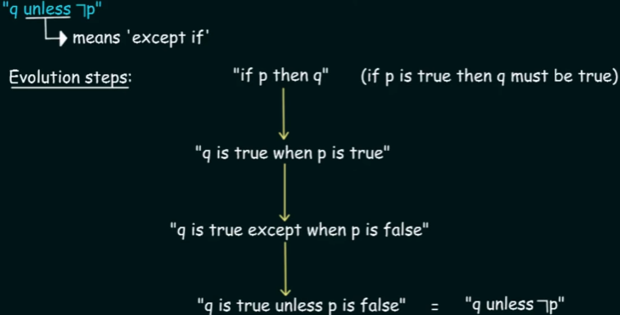
Logical Operators
Why p is not necessary for q?
Proof by contradiction: Let say p is necessary for q.
If p is really necessary for q then if p is false then it is mandatory for q to be false in order to make the whole compound proposition true. But it is not the case. According to the truth table, it is not mandatory for q to be false when p is false. Hence "p is not necessary for q."
Why q is not sufficient for p?
Proof by contradiction: Let say q is sufficient for p.
If q is really sufficient for p then if q is true then it is mandatory for p to be true in order to make the whole compound proposition true. But it is not the case. According to the truth table it is not mandatory for p to be true when q is true. Hence "q is not sufficient for p."
Representations of Implication
"q unless ¬p"

Slide 22
Logical Operators
Converse, Contrapositive & Inverse
Implication: p → q “If it rains today then, I will stay at home.”
Converse: q → p “If I will stay at home, then it rains today.”
Contrapositive: ¬q → ¬p “If I will not stay at home, then it does not rain today.”
Inverse: ¬p → ¬q “It it does not rain today then, I will not stay at home.”
Implication & contrapositive are equivalent, whereas converse and inverse are equivalent.
Neither converse nor inverse is equivalent to implication.
p | q | ¬p | ¬q | p → q | q → p | ¬q → ¬p | ¬p → ¬q
T | T | F | F | T | T | T | T
T | F | F | T | F | T | F | T
F | T | T | F | T | F | T | F
F | F | T | T | T | T | T | T
If you receive A grade in CS then, you will be awarded a scholarship.
If exercise is good for health then, I will go to the park.

Slide 23
Logical Operators
Biconditional Operator (Double Implication)
p ↔ q p if and only if q (p → q) ∧ (q → p)
True whenever the truth values of p and q are same.
p is necessary and sufficient for q and vice versa
if p then q and conversely (p iff q).
p if and only if q is composed of p if q and p only if q
p only if q = if p then q and p if q = if q then p
So, (p → q) and (q → p) ≡ p ↔ q
p | q | p ↔ q
T | T | T
T | F | F
F | T | F
F | F | T
p: “You get promoted” q: “You have connections” p ↔ q: “You get promoted if and only if you have connections.”
If you read newspaper everyday, you will be informed and conversely. You read the newspaper everyday if and only if you will be informed.
It rains if it is a weekend day, and it is a weekend day if it rains. It rains if and only if it is a weekend day.
The trains run late on exactly those days when I take it. The trains run late if and only if I take it.
For you to get an A in this course, it is necessary and sufficient that you learn how to solve discrete mathematics problems. You get an A in this course if and only if you learn how to solve discrete mathematics problems.

Slide 24
Logical Operators
NET November 2017 Paper 3
"If X, then Y unless Z" is represented by which of the following formulae in propositional logic?
i ➔ (X ∧ Y) → ¬Z ii ➔ (X ∧ ¬Z) → Y
iii ➔ X → (Y ∧ ¬Z) iv ➔ Y → (X ∧ ¬Z)
✅
If the statement "p ∧ q" is true, which of the following must also be true?
i ➔ p is true ii ➔ q is false iii ➔ p is false iv ➔ None of the above
If p ↔ q is true, which of the following must also be true?
i ➔ p and q have the same truth value ii ➔ p is true iii ➔ q is false iv ➔ p and q have opposite truth values
If p ∨ q is true and ¬p is true, then q must be true.
i ➔ Valid ii ➔ Invalid iii ➔ Valid only if p is true iv ➔ Can't be determined
✅
✅
✅

Slide 25
p: "Today is Friday" q: "It is raining today"
¬p: “Today is not friday” ¬q: “It is not raining today”
p ∧ q: "Today is Friday and it is raining today."
p ∨ q: "Today is Friday or it is raining today."
p ⊕ q: "Either today is Friday or it is raining today, but not both."
p → q: "If it is Friday, then it is raining today"
p ↔ q: "It is raining today if and only if it is Friday today"
Logical Operators
Consider the following statements:
P: Good mobile phones are not cheap.
Q: Cheap mobile phones are not good.
L: P implies Q
M: Q implies P
N: P is equivalent to Q
Which one of the following about L, M, and N is CORRECT?
(A) Only L is TRUE.
(B) Only M is TRUE.
(C) Only N is TRUE.
(D) L, M, and N are TRUE.
✅

Slide 26
Precedence of
Logical Operators
Operators | Names | Precedence
¬ | Negation | 1
∧ | Conjunction | 2
∨ | Disjunction | 3
→ | Implication | 4
↔ | Biconditional | 5
Helps to decide which operator will get evaluated first in a complicated compound proposition.
p → q ∧ ¬p
p | q | ¬p | q ∧ ¬p | p → q ∧ ¬p
T | T | F | F | F
T | F | F | F | F
F | T | T | T | T
F | F | T | F | T
p → ¬q ∧ ¬p ↔ ¬q
p | q | ¬p | ¬q | ¬q ∧ ¬p | p → ¬q ∧ ¬p | p → ¬q ∧ ¬p ↔ ¬q
T | T | F | F | F | F | T
T | F | F | T | F | F | F
F | T | T | F | F | T | F
F | F | T | T | T | T | T

Slide 27
Translating English Sentences into Logical Expressions
Are these system specifications consistent?
"The system is in multiuser state if and only if it is operating normally."
"If the system is operating normally, then the kernel is functioning."
"The kernel is not functioning or the system is in interrupt mode."
"If the system is not in multiuser state, then it is in interrupt mode."
"The system is not in interrupt mode
Consistent means assigning truth values to propositional variables in such a way that finally we would be able to make all specifications 'true'.
p = "The system is in multiuser state." q = "The system is operating normally."
r = "The kernel is functioning." s = "The system is in interrupt mode."
p ↔ q q → r ¬r ∨ s ¬p → s ¬s
Always start from the statement which involves least number of propositions.
Removes ambiguity
Easy manipulation
Able to solve puzzles
"You are not allowed to marry if your age is less than 18 years or you have no age proof."
q: "You are allowed to marry"
r: "Your age is less than 18 years"
s: "You have age proof"
Statement follows the structure "A if B" (which means If B then A)
The logical expression: (r ∨ ¬s) → ¬q

Slide 28
In an Island there are two kinds of inhabitants, Knights, who always tell the truth, and their opposites, Knaves, who always lie. You encounter two people A and B. Determine, if possible, what A and B are if they address you in the ways described:
A says “B is a Knight” and B says “The two of us are opposite types”.
Let p = A is knight and q = B is knight
Case 1:
Suppose A is knight: p is T
Whatever A says will be true: q is T
So B is knight, whatever B says must be true:
(p ∧ ¬q) ∨ (¬p ∧ q) must be T, but became F.
Hence A is knave: a contradiction. ❌
Case 2:
Suppose B is knight: q is T
Whatever B says will be true:
(p ∧ ¬q) ∨ (¬p ∧ q) will be T, only if p is F
So A is knave, whatever A says will be false: q is F
Hence B is knave: a contradiction. ❌
So ¬p = A is knave and ¬q = B is knave
Case 3:
Suppose A is knave: p is F
Whatever A says will be false: q is F
So B is knave, whatever B says must be false:
(p ∧ ¬q) ∨ (¬p ∧ q) must be F, and is proved to be F.
Hence A is knave ✅
Case 4:
Suppose B is knave: q is F
Whatever B says will be false:
(p ∧ ¬q) ∨ (¬p ∧ q) will be F, only if p is F
So A is knave, whatever A says will be false: q is F
Hence B is knave ✅
Hence A is a knave and B is a knave.

Slide 29
In an Island there are two kinds of inhabitants, Knights, who always tell the truth, and their opposites, Knaves, who always lie. You encounter two people A and B. Determine, if possible, what A and B are if they address you in the ways described:
A says “Atleast one of us is a knave” and B says nothing.
Let p = A is knight and q = B is knight
Case 1:
Suppose A is knight: p is T
Whatever A says will be true:
Either A or B or both are knaves:
(p ∧ ¬q) ∨ (¬p ∧ q) ∨ (¬p ∧ ¬q) will be T, only if q is F.
So B is knave and hence A is knight ✅
Case 2:
Suppose B is knight: q is T
Whatever B says will be true:
But B said nothing ❌
So ¬p = A is knave and ¬q = B is knave
Case 3:
Suppose A is knave: p is F
Whatever A says will be false:
None of them are knaves
But then A cannot be knave
Hence A is knight: a contradiction ❌
Case 4:
Suppose B is knave: q is F
Whatever B says will be false:
But B said nothing ❌
Hence A is a knight and B is a knave.

Slide 30
In an Island there are two kinds of inhabitants, Knights, who always tell the truth, and their opposites, Knaves, who always lie. You encounter two people A and B. Determine, if possible, what A and B are if they address you in the ways described:
A says “The two of us are both knights” and B says “A is a knave”.
Let p = A is knight and q = B is knight
Case 1:
Suppose A is knight: p is T
Whatever A says will be true:
So B is also a knight q is T
Whatever B says should be true.
So A is a knave: a contradiction ❌
Case 2:
Suppose B is knight: q is T
Whatever B says will be true, so A is a knave p is F Whatever A says will be false.
So A is a knave and hence B is knight ✅
So ¬p = A is knave and ¬q = B is knave
Case 3:
Suppose A is knave: p is F
Whatever A says will be false:
As B says A is a knave, B is a knight
Hence A is knave ✅
Case 4:
Suppose B is knave: q is F
Whatever B says will be false: p is T
So A is a knight, whatever A says should be true.
Hence B is a knight: a contradiction ❌
Hence A is a knave and B is a knight.

Slide 31
In an Island there are two kinds of inhabitants, Knights, who always tell the truth, and their opposites, Knaves, who always lie. You encounter two people A and B. Determine, if possible, what A and B are if they address you in the ways described:
A says “I am a knave or B is a knight” and B says nothing.
Let p = A is knight and q = B is knight
Case 1:
Suppose A is knight: p is T
Whatever A says will be true:
So A is a knave or B is a knight must be true:
¬p ∨ q is T, only if q is T.
So B is knight. and hence A is knight: ✅
Case 2:
Suppose B is knight: q is T
Whatever B says will be true:
But B said nothing ❌
So ¬p = A is knave and ¬q = B is knave
Case 3:
Suppose A is knave: p is F
Whatever A says will be false:
So A is a knave or B is a knight must be false:
But ¬p ∨ q is always T, as p is F
Hence A is knight: a contradiction ❌
Case 4:
Suppose B is knave: q is F
Whatever B says will be false:
But B said nothing ❌
Hence A is a knight and B is a knight.

Slide 32
In an Island there are two kinds of inhabitants, Knights, who always tell the truth, and their opposites, Knaves, who always lie. You encounter two people A and B. Determine, if possible, what A and B are if they address you in the ways described:
Both A and B say “I am a knight”.
Let p = A is knight and q = B is knight
Case 1:
Suppose A is knight: p is T
Whatever A says will be true:
So A is a knight
Case 2:
Suppose B is knight: q is T
Whatever B says will be true:
So B is a knight
So ¬p = A is knave and ¬q = B is knave
Case 3:
Suppose A is knave: p is F
Whatever A says will be false:
So A is a knave
Case 4:
Suppose B is knave: q is F
Whatever B says will be false:
So B is a knave
It is impossible to determine the identities of A and B based solely on these statements.

Slide 33
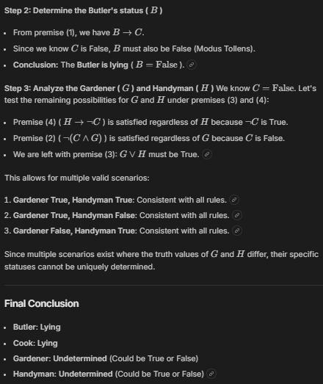
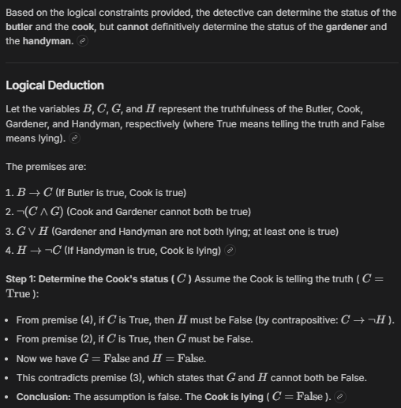
A detective has interviewed four witnesses to a crime. From the stories of the witnesses the detective has concluded that if the butler is telling the truth then so is the cook; the cook and the gardener cannot both be telling the truth; the gardener and the handyman are not both lying; and if the handyman is telling the truth then the cook is lying. For each of the four witnesses, can the detective determine whether that person is telling the truth or lying?

Slide 34
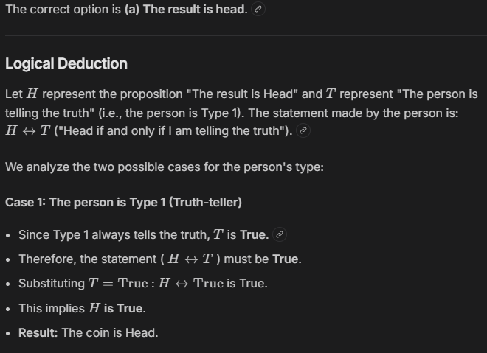
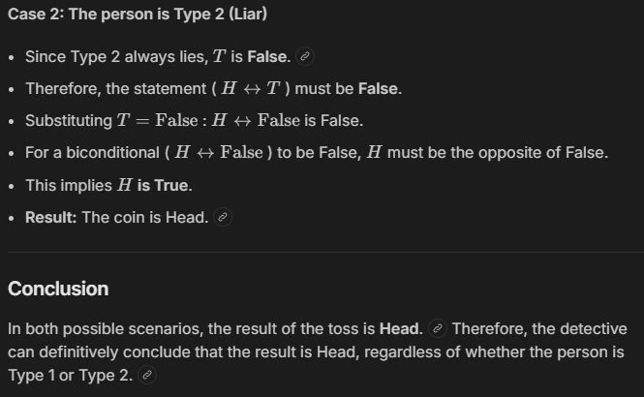
In a room there are only two types of people, namely Type 1 and Type 2. Type 1 people always tell the truth and Type 2 people always lie. You give a fair coin to a person in that room, without knowing which type he is from and tell him to toss it and hide the result from you till you ask for it. Upon asking, the person replies the following. "The Result of the toss is head if and only if I am saying the truth." Which of the following options is correct? (a) The result is head. (b) The result is tail. (c) If the person is of Type 2, then the result is tail. (d) If the person is of Type 1, then the result is tail. [GATE 2015 (Set - 3)]

Slide 35
Tautology
Compound proposition which is always TRUE.
Eg: p ∨ ¬p
Satisfiability
A compound proposition is satisfiable if there is at least one TRUE result in its truth table.
Eg: p ∧ q is satisfiable.
A tautology is always satisfiable but satisfiable is not always tautology.
Contradiction
Compound proposition which is always FALSE.
Eg: p ∧ ¬p
Unsatisfiability
A compound proposition is unsatisfiable if there is not even a single TRUE result in its truth table.
A contradiction is always unsatisfiable.
Contingency
Compound proposition which is sometimes TRUE and sometimes FALSE.
Eg: p ∧ q
Valid
A compound proposition is valid when it is a tautology.
Tautology | Contradiction | Contingency
T | F | T/F
Satisfiable | Unsatisfiable | Satisfiable
Valid | Invalid | Invalid
Invalid
A compound proposition is invalid when it is either a contradiction or contingency.

Slide 36
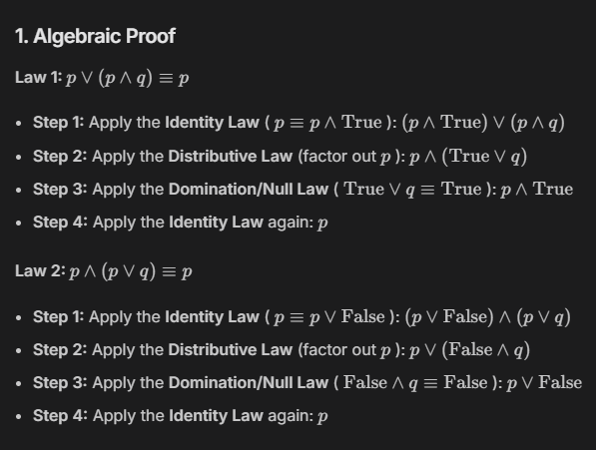
Logical Equivalences
The compound propositions p and q are said to be logically equivalent if p↔q is a tautology.
Denoted by ≡ or ⇔
Identity Laws | p ∨ F ≡ p | p ⋀ T ≡ p
Domination Laws | p ∨ T ≡ T | p ⋀ F ≡ F
Idempotent Laws | p ∨ p ≡ p | p ⋀ p ≡ p
Double Negation Law | ￢(￢p) ≡ p
Commutative Laws | p ∨ q ≡ q ∨ p | p ⋀ q ≡ q ⋀ p
Associative Laws | (p ∨ q) ∨ r ≡ p ∨ (q ∨ r) | (p ⋀ q) ⋀ r ≡ p ⋀ (q ⋀ r)
Distributive Laws | p ∨ (q ⋀ r) ≡ (p ∨ q) ⋀ (p ∨ r) | p ⋀ (q ∨ r) ≡ (p ⋀ q) ∨ (p ⋀ r)
De Morgan’s Laws | ￢(p ⋀ q) ≡ ￢p ∨ ￢q | ￢(p ∨ q) ≡ ￢p ⋀ ￢q
Absorption Laws | p ∨ (p ⋀ q) ≡ p | p ⋀ (p ∨ q) ≡ p
Negation Laws | p ∨ ￢p ≡ T | p ⋀ ￢p ≡ F

Slide 37
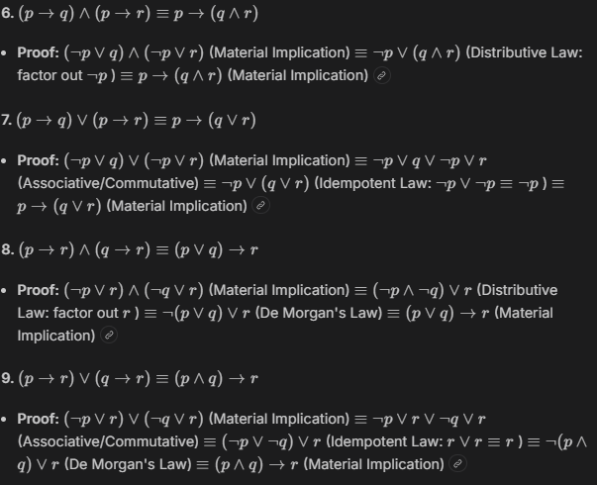
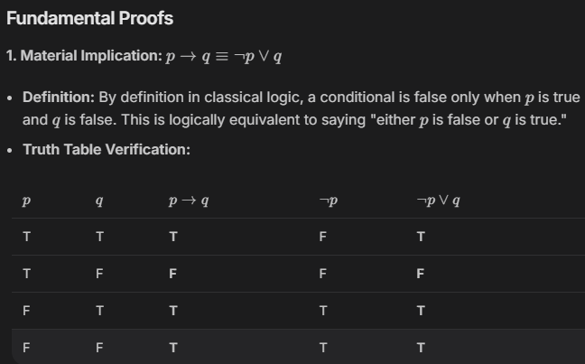
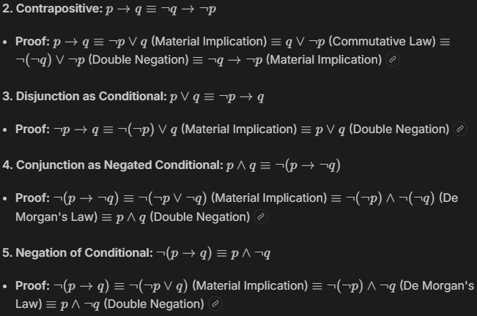
Logical Equivalences
Conditionals
p → q ≡ ￢p ∨ q
p → q ≡ ￢q → ￢p
p ∨ q ≡ ￢p → q
p ⋀ q ≡ ￢(q → ￢p)
￢(p → q) ≡ p ⋀ ￢q
(p → q) ⋀ (p → r) ≡ p → (q ⋀ r)
(p → q) ∨ (p → r) ≡ p → (q ∨ r)
(p → r) ⋀ (q → r) ≡ (p ∨ q) → r
(p → r) ∨ (q → r) ≡ (p ⋀ q) → r

Slide 38
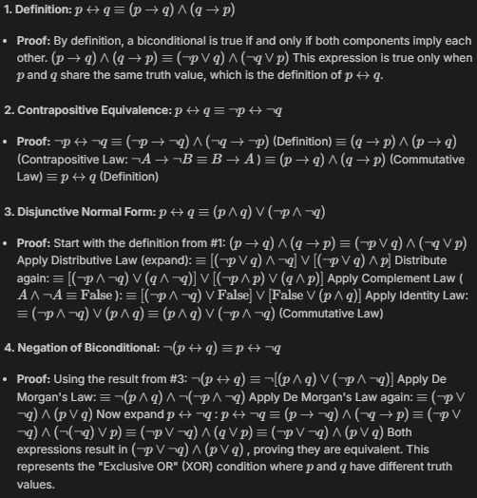
Logical Equivalences
Biconditionals
p ↔ q ≡ (p → q) ⋀ (q → p)
p ↔ q ≡ ￢p ↔ ￢q
p ↔ q ≡ (p ⋀ q) ∨ (￢p ⋀ ￢q)
￢(p ↔ q) ≡ p ↔ ￢q

Slide 39
Logical Equivalences
Which of the following is a tautology?
p∧¬p p∨¬p p→¬p ¬p→p
If the statement "p ∧ q" is true, which of the following must also be true?
p is true q is false
p is false None of the above
If p↔q is true, which of the following must also be true?
p and q have the same truth value.
p is true.
q is false
p and q have opposite truth values.
If p ∨ q is true and ¬p is true, then q must be true.
Valid Invalid
Valid only if p is true Can't be determined
Applications
Digital Logic Design: to simplify Boolean expressions, in designing simpler, faster, and more efficient digital circuits.
Software Engineering: to simplify conditional statements and logical expressions in programs, making the code easier to read, understand, and optimize.
Theoretical Computer Science: to analyze algorithms, prove logical correctness, and improve computational efficiency.
Control Systems: to simplify logical conditions, helping control systems work more accurately, efficiently, and reliably.
✅
✅
✅
✅

Slide 40
The Boolean Expression
(p∧ ~q)∨q∨( ~p∧q) is equivalent to
p ∧ q p ∨ q p ∨ ¬q ¬p ∧ q
The negation of the compound proposition p∨( ¬p∨q) is
(p ∧ ¬q) ∧ ¬p (p ∧ ¬q) ∨ ¬p
(p ∨ ¬q) ∨ ¬p None of these
The inverse of the proposition (p ∧ ~q) ⇒ r is
¬r ⇒ ¬p∨q ¬p∨q ⇒ ¬r
r ⇒ p ∧ ¬q None of the these
The propositions (p⇒ ¬p)∧( ¬p ⇒ p) is a
Tautology and Contradiction
Neither Tautology nor Contradiction
Contradiction
Tautology
✅
✅
(p ∧ ¬q)∧( ¬p∨q) is
A A contradiction B A tautology
C Either A or B D Neither A nor B
✅
✅
If (p ∧ ~r)⇒(q∨r) is false and q and r are both false, then p is
True False True/False Data insufficient
✅
✅

Slide 41
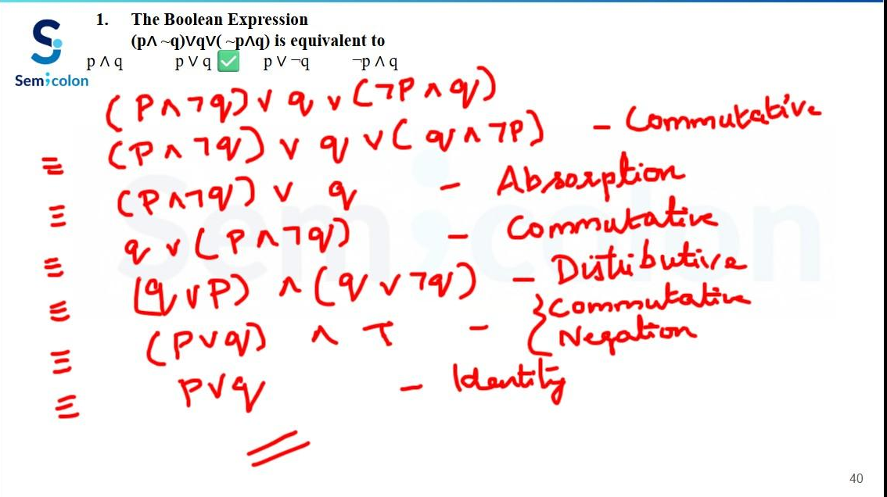

Slide 42
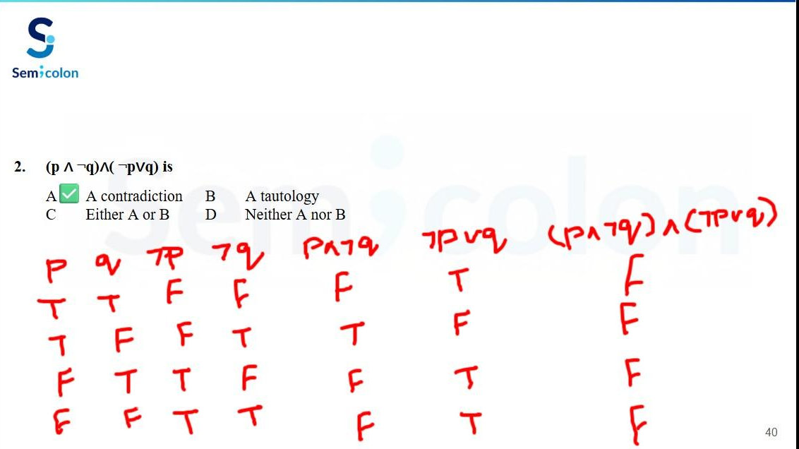

Slide 43
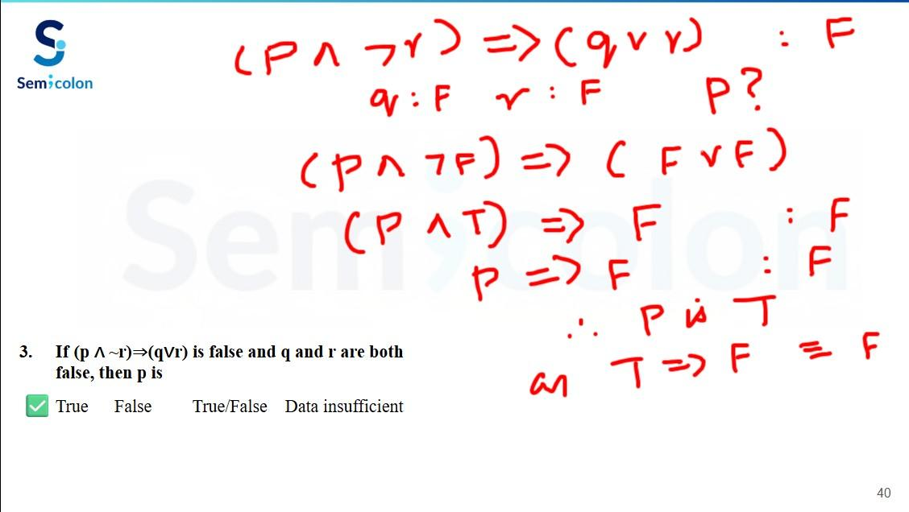

Slide 44
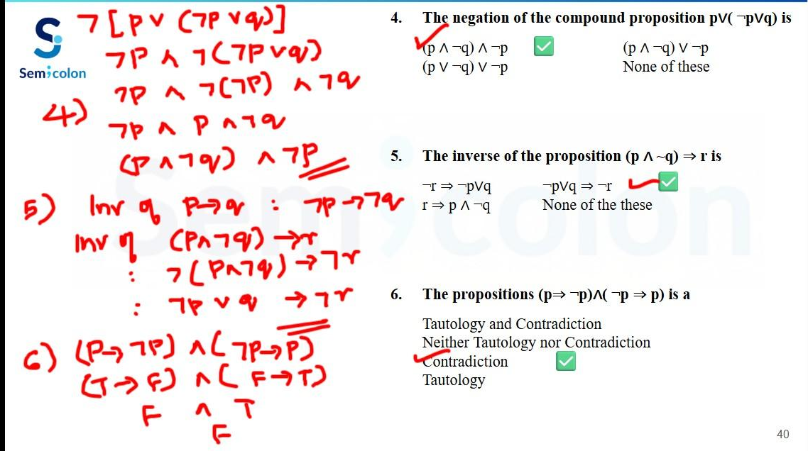

Slide 45
Simplify (p∨q)∧(¬p∨q) to an equivalent expression using logical laws.
P: p→(q∨r) and Q: (p→q)∨(p→r).
Are P and Q logically equivalent? Justify using a truth table.
Which sequence of laws is used to prove that
p ∧ (p ∨ q) ≡ p?
Commutative Law, Identity Law, Negation Law
Distributive Law, Idempotent Law, Absorption Law
De Morgan's Law, Double Negation Law, Identity Law
Associative Law, Domination Law, Commutative Law
“It is raining” (r) “The ground is wet” (w)
Check if the statement (r→w)∧(w→r) is logically equivalent to ¬r∨w. Justify with truth table
Which one of the following is not equivalent to p <-> q
(¬p∨q)∧(p∨¬q) (¬p∨q)∧(q→p)
(¬p∧q)∨(p∧¬q) (¬p∧¬q)∨(p∧q)
✅
✅

Slide 46
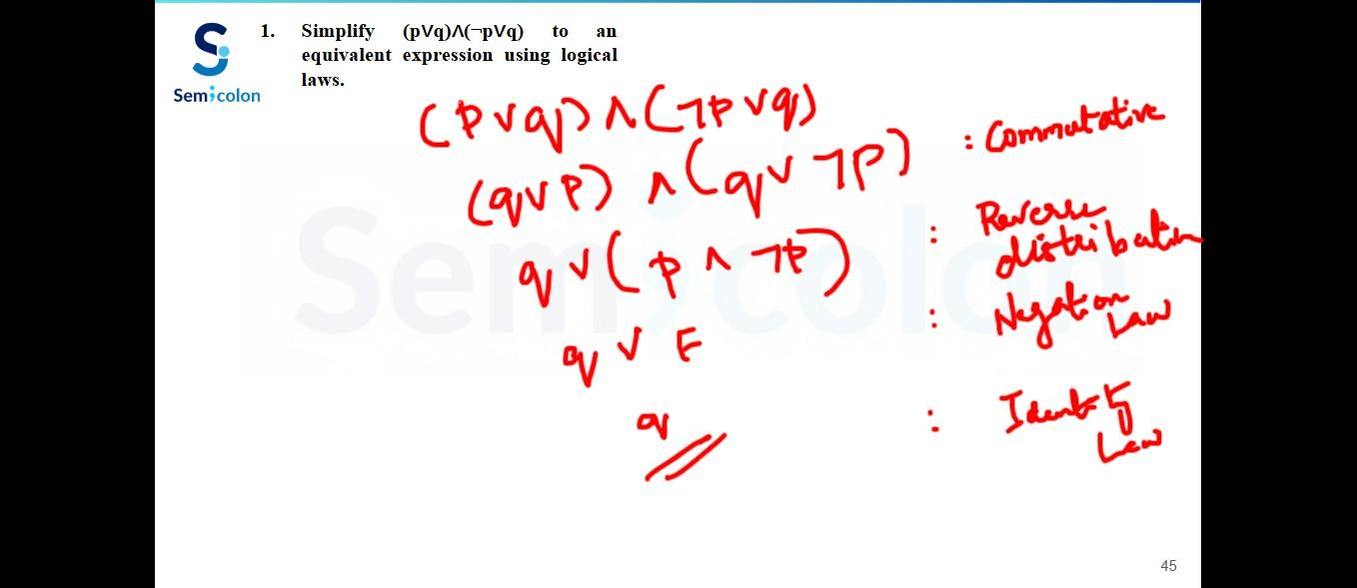

Slide 47
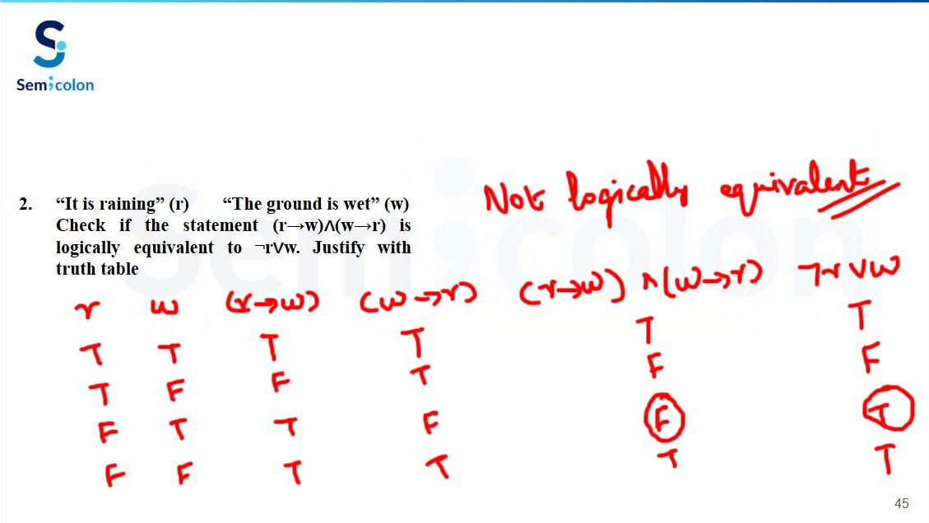

Slide 48
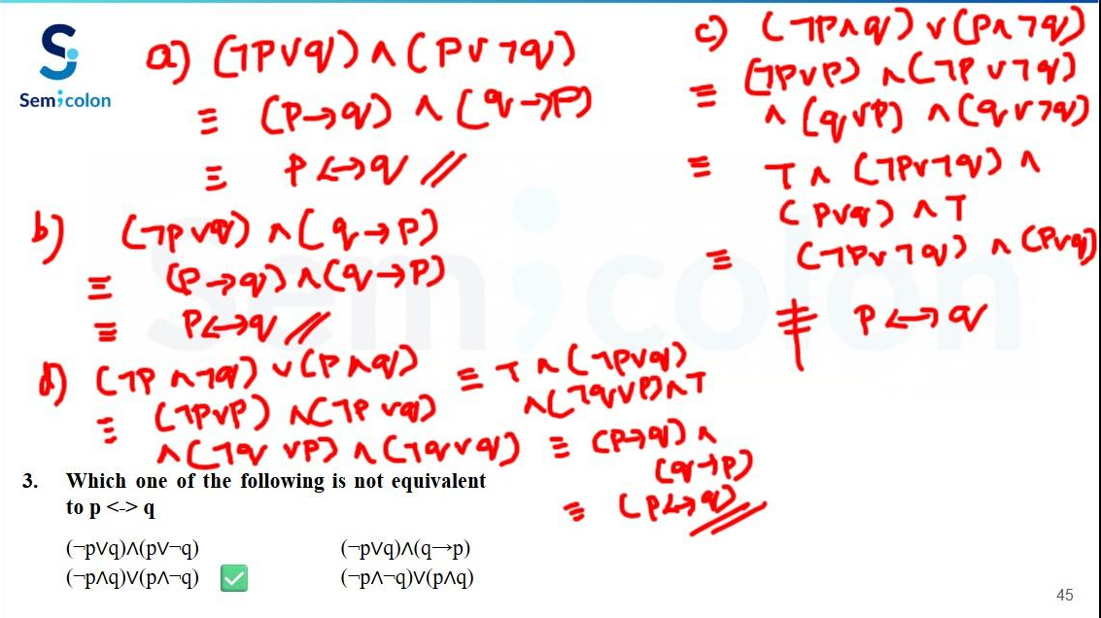

Slide 49
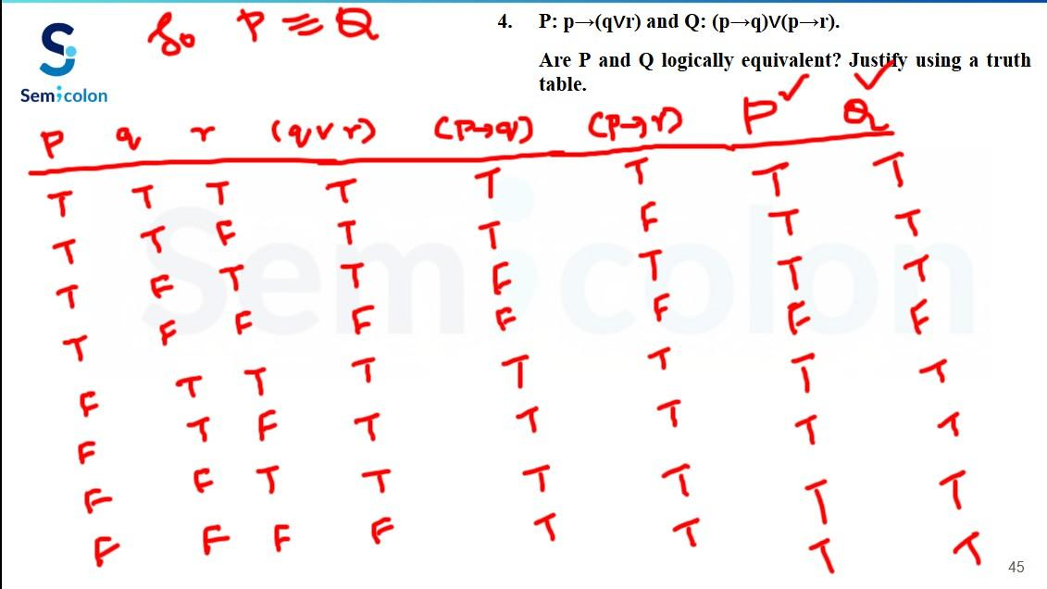

Slide 50
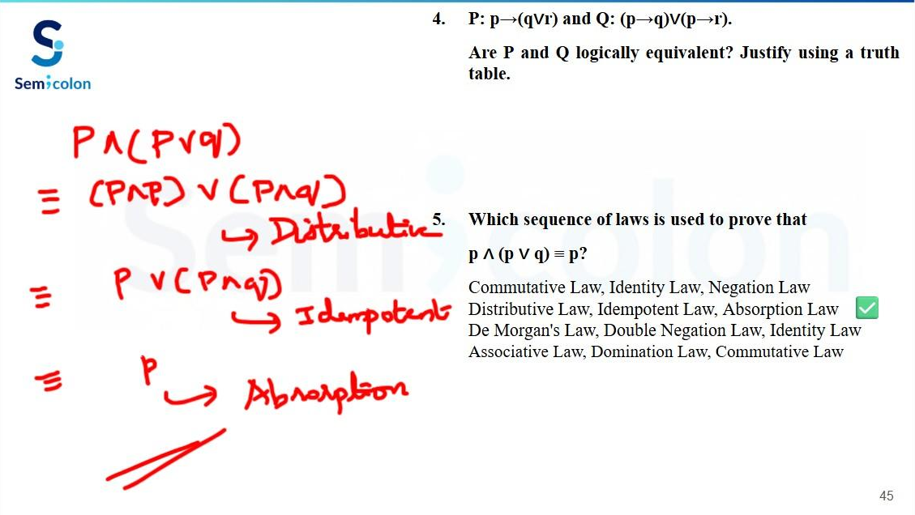

Slide 51
Prove that (p → q) ∧ (p → ¬q) ≡ ¬p.
Prove that p → (q → r) ≡ (p ∧ q) → r.
Show that (p ∨ q) ∧ (p ∨ r) ≡ p ∨ (q ∧ r).
To prove (p ∧ q) → r ≡ p → (q → r), which combination of laws is applied in the correct order?
De Morgan's, Distributive, Commutative, Implication
Implication, De Morgan's, Associative, Implication twice
Absorption, Idempotent, Negation, Implication
Double Negation, Commutative, De Morgan's, Identity
P: "If I study, I will pass." (s→p)
Q: "If I do not pass, then I did not study." (¬p→¬s)
R: "If I pass, then I studied." (p→s)
Which of the following is true?
P and Q are equivalent, but not R
P and R are equivalent, but not Q
All three are equivalent
None are equivalent
✅
✅

Slide 52
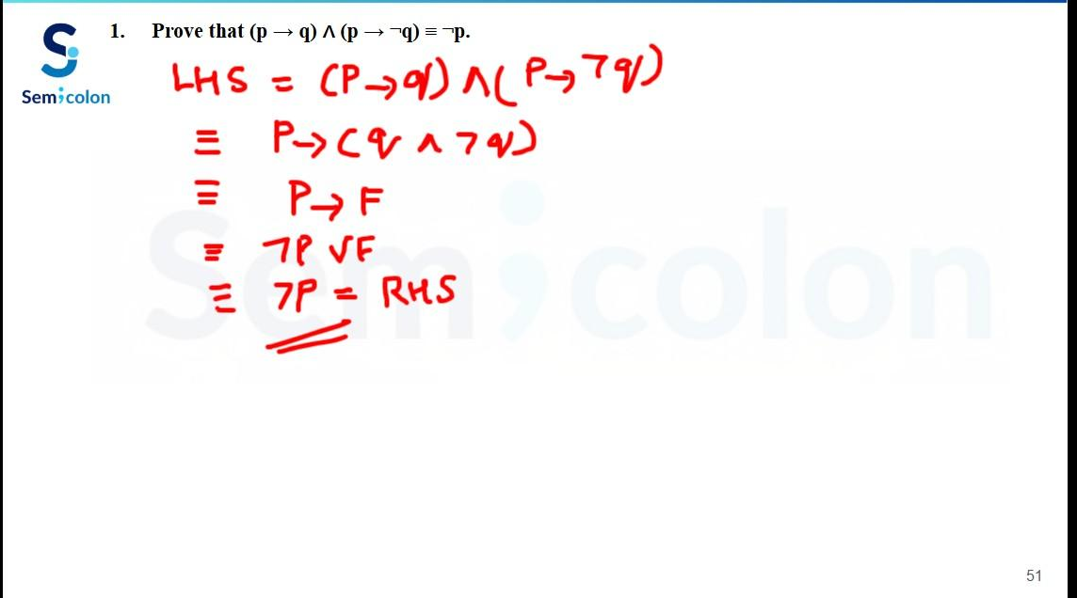
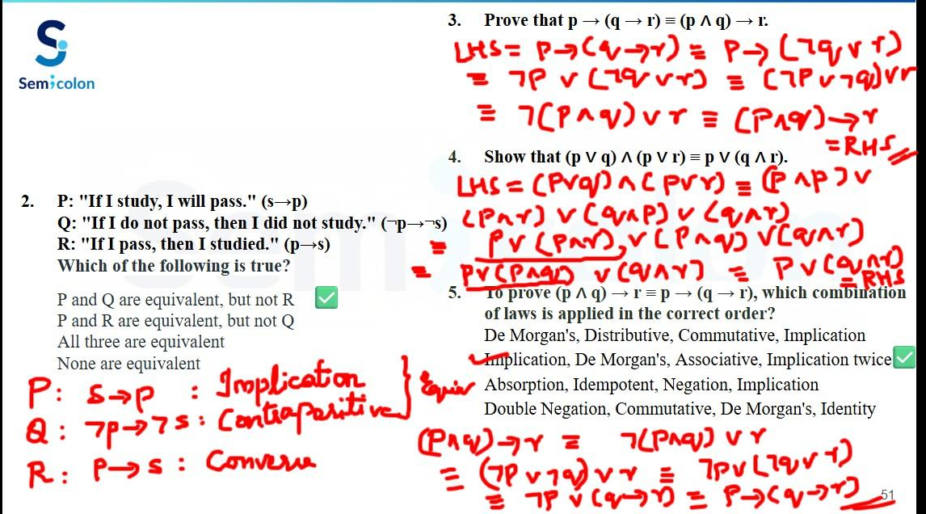

Slide 53
NET November 2017 Paper 3
Let P, Q, R and S be Propositions. Assume that the equivalences P⇔(Q∨¬Q) and Q⇔R hold.
Then the truth value of the formula (P∧Q)⇒((P∧R)∨S) is always:
True False Same as truth table of Q Same as truth table of S
✅
GATE 2008
P and Q are two propositions. Which of the following Logical expressions are equivalent?
P∨¬Q
¬(¬P∧Q)
(P∧Q)∨(P∧¬Q)∨(¬P∧¬Q)
(P∧Q)∨(P∧¬Q)∨(¬P∧Q)
Only 1 and 2 Only 1, 2 and 3
Only 1, 2 and 4 All of these
✅

Slide 54
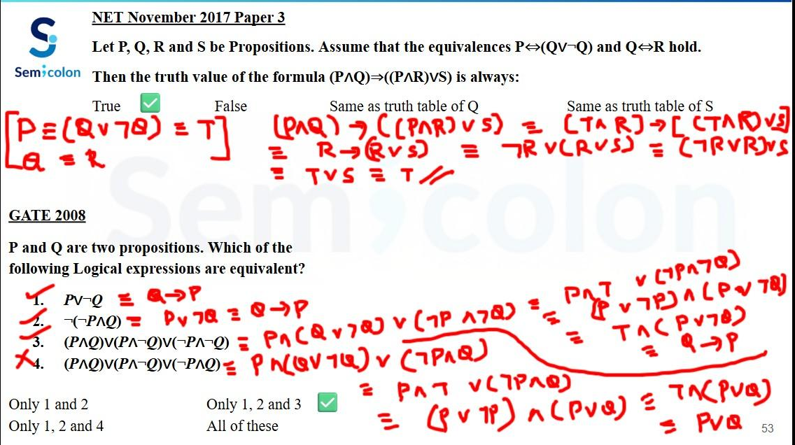

Slide 55
GATE 2014
Which one of the following boolean expression is NOT a tautology?
((a -> b) ^ (b -> c)) -> (a -> c) (a <-> c) -> (~b -> (a ^ c))
(a ^ b ^ c) -> (c v a) a -> (b -> a)
✅
GATE 2004
The following propositional statement is
(P -> (Q v R)) -> ((P ^ Q) -> R)
(a) satisfiable but not valid
(b) valid
(c) a contradiction
(d) None of the above
✅

Slide 56
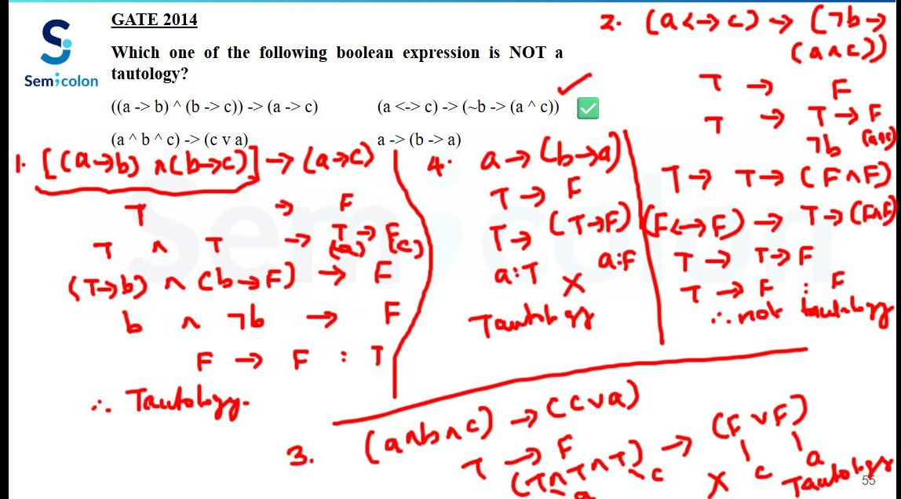

Slide 57
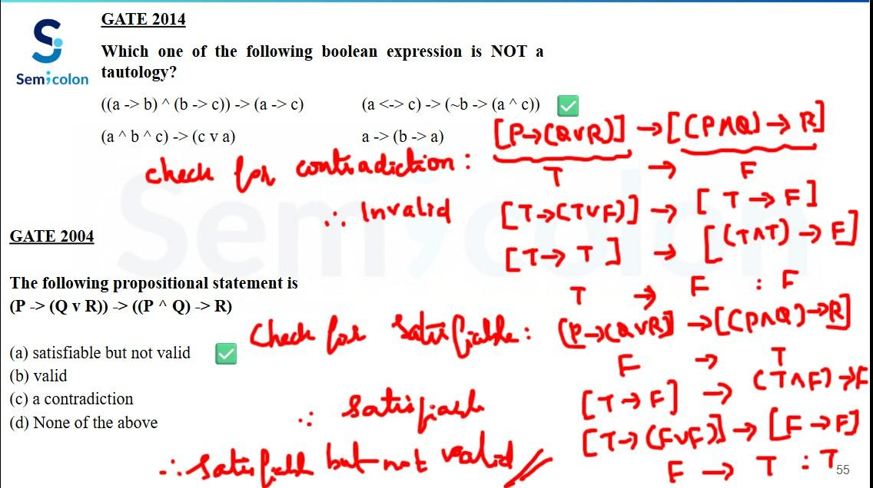

Slide 58
GATE 2005
Define X as (P ∨ Q) → R and Y as (P → R) ∨ (Q → R). Which one of the following is a tautology?
X ≡ Y X → Y Y → X ~Y → X
✅
GATE 2009
Which one of the following is equivalent to P ∨ Q ?
(a) ~Q □ ~P
(b) P □ ~Q
(c) ~P □ Q
(d) ~P □ ~Q
P | Q | P □ Q
T | T | T
T | F | T
F | T | F
F | F | T
✅

Slide 59
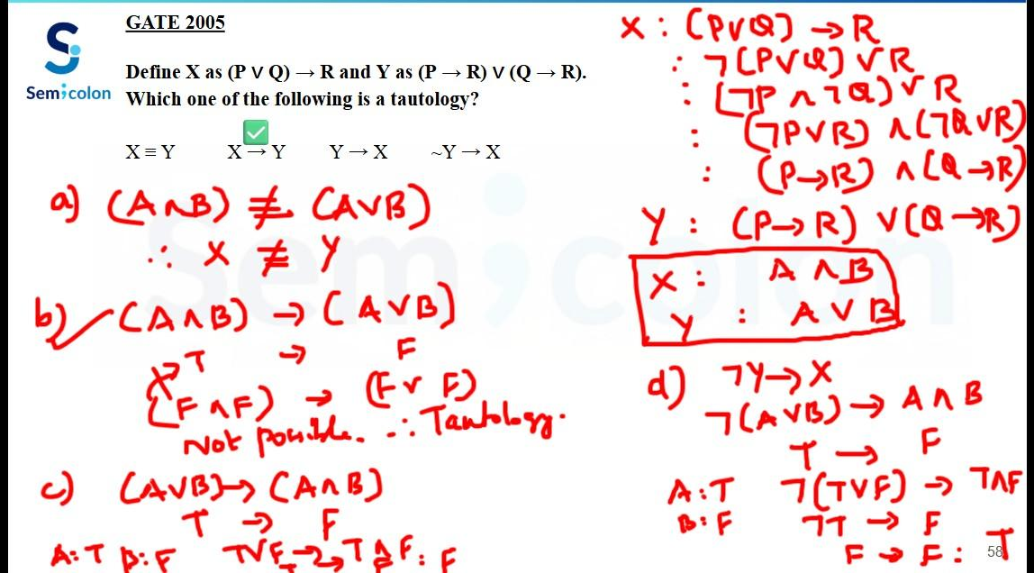

Slide 60
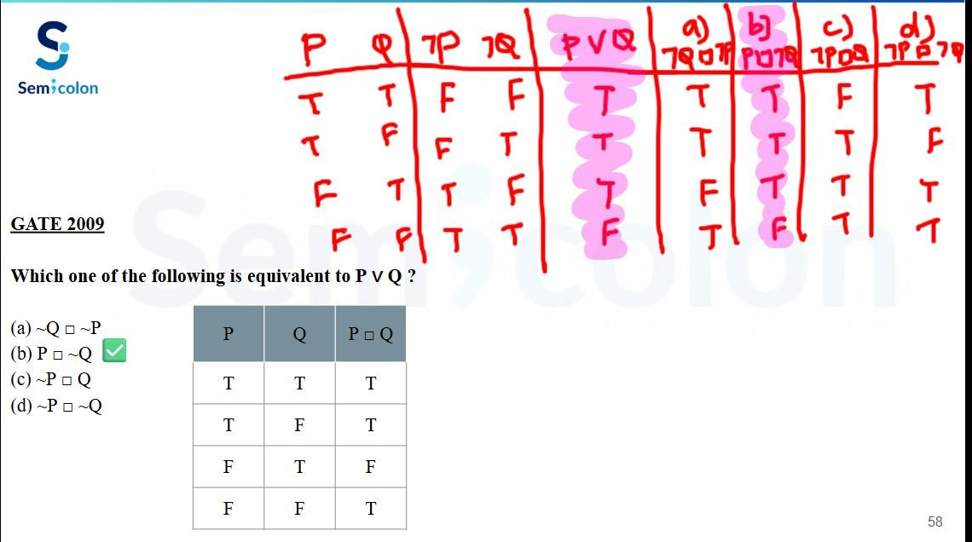

Slide 61
Logical Implication
The compound propositions p and q are logical implication if p→q is a tautology.
Denoted by p ⇒ q
GATE 2016
Consider the following expressions:
i. False ii. Q iii. True iv. P ∨ Q v. ¬Q ∨ P
The number of expressions given above that are logically implied by P ∧ (P -> Q) is?

Slide 62
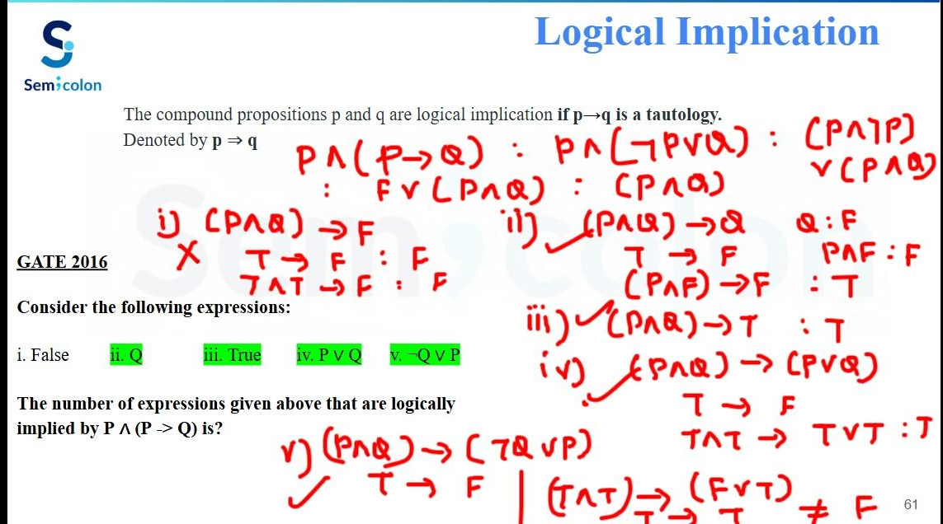

Slide 63
Rules of Inference in Propositional Logic
Basic Terminology and Examples
Premise:
A proposition on the basis of which we would able to draw a conclusion.
An Evidence or assumption.
Initially we assume something is true and on the basis of that assumption, we draw some conclusion.
Conclusion:
A proposition that is reached from the given set of premises.
Result of the assumptions that was made in an argument.
if premise then conclusion

Slide 64
Rules of Inference in Propositional Logic
Basic Terminology and Examples
Argument:
Sequence of statements that ends with a conclusion.
Set of one or more premises and a conclusion.
Valid Argument Invalid Argument
An argument is said to be valid if and only if it is not An argument is said to be invalid if and only if it is
possible to make all premises true and a conclusion false. possible to make all premises true and a conclusion false.
p: I love cat q: I love dog p: I love cat q: I love dog
P1: "If I love cat then I love dog." p → q P1: "If I love cat then I love dog." p → q
P2: "I love cat." p P2: "I love dog." q
C: Therefore, "I love dog." ∴ q C: Therefore, "I love cat." ∴ p
Logical Form: [(p→q)∧p]→q [(p→q)∧q]→p

Slide 65
Rules of Inference in Propositional Logic
Definition and Types of Inference Rules
Inference: Deriving conclusions from evidences.
Rules of Inference: Templates for constructing valid arguments.
Types of Inference Rules:
1. Modus Ponens
(Rule of detachment) (Transitive)
p → q
p
∴ q
[(p→q)∧p]→q
2. Modus Tollens
p → q
¬q
∴ ¬p
[(p→q)∧¬q]→¬p
3. Hypothetical Syllogism
p → q
q → r
∴ p → r
[(p→q)∧(q → r)]→(p → r)
4. Disjunctive Syllogism
p ∨ q
¬p
∴ q
[(p∨q)∧¬p]→q

Slide 66
Rules of Inference in Propositional Logic
Definition and Types of Inference Rules
Types of Inference Rules:
5. Addition
p
∴ p ∨ q
p→(p ∨ q)
6. Simplification
p ∧ q or p ∧ q
∴ p ∴ q
(p∧q)→p or (p∧q)→q
7. Conjunction
p
q
∴ p ∧ q
[(p)∧(q)]→(p∧q)
8. Resolution
p ∨ q
¬p ∨ r
∴ q ∨ r
[(p∨q)∧(¬p∨r)]→(q∨r)

Slide 67
Rules of Inference in Propositional Logic
Building Arguments using Rules of Inference
Premises: "Randy works hard",
"If Randy works hard, then he is a dull boy", and
"If Randy is a dull boy, then he will not get the job".
Conclusion: "Randy will not get the job."
Let H = Randy works hard,
D = Randy is a dull boy,
J = Randy will get the Job.

Slide 68
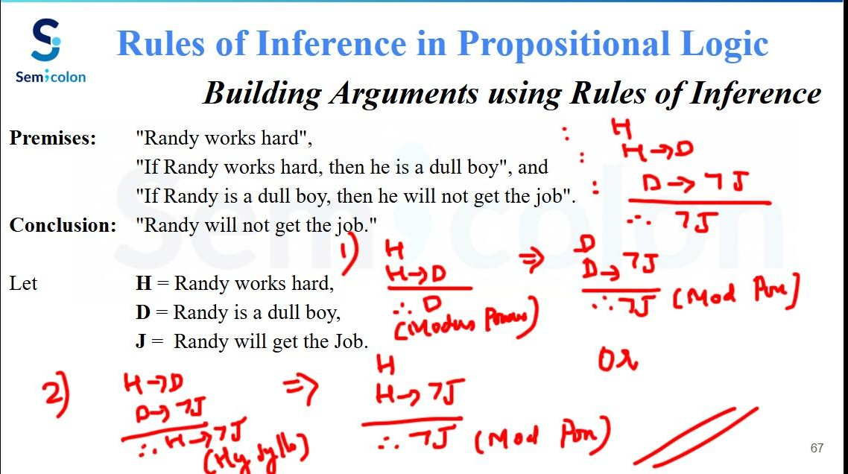

Slide 69
Rules of Inference in Propositional Logic
Building Arguments using Rules of Inference
Premises: "If it does not rain or if it is not foggy, then the sailing race will
be held and the lifesaving demonstration will go on"
"If the sailing race is held, then the trophy will be awarded", and
"The trophy was not awarded."
Conclusion: "It rained."
Let R : It rains
F : It is foggy
S : The sailing race is held
D : The lifesaving demonstration goes on
T : The trophy is awarded

Slide 70
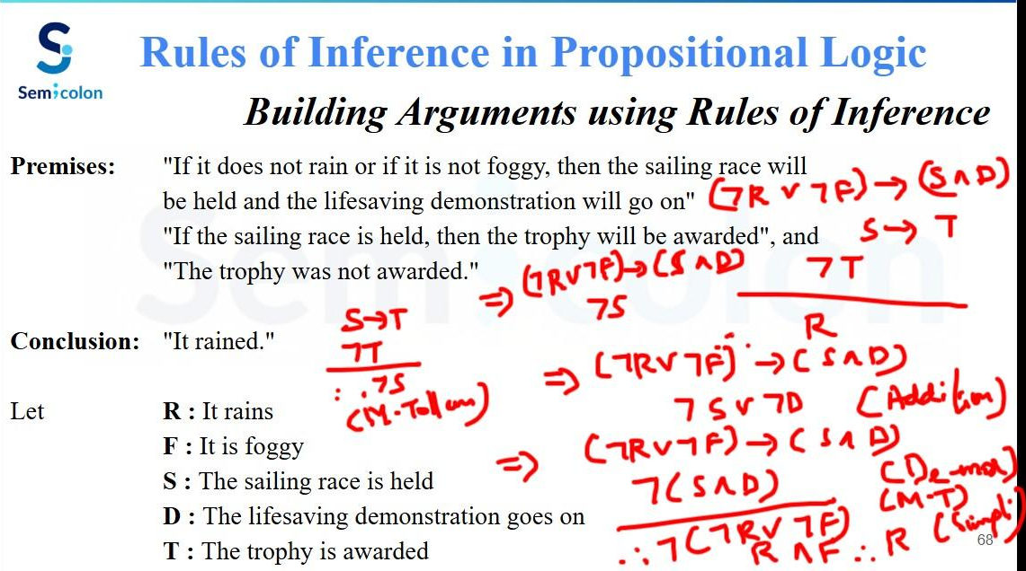

Slide 71
Rules of Inference in Propositional Logic
Building Arguments using Rules of Inference
Problem: Show that the following argument is valid.
If today is Tuesday, then I have a test in Mathematics or Economics.
If my Economics Professor is sick, then I will not have a test in Economics.
Today is Tuesday and my Economics Professor is sick.
Therefore I have a test in Mathematics.
Solution: Let T = Today is Tuesday, M = I have a test in Mathematics, E = I have a test in Economics and S = My Economics Professor is sick.

Slide 72
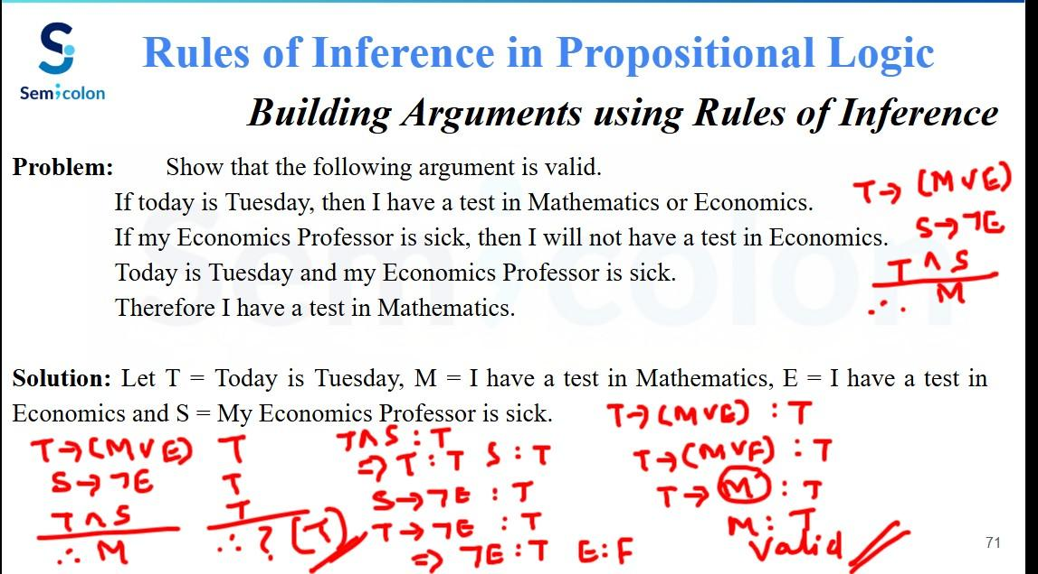

Slide 73
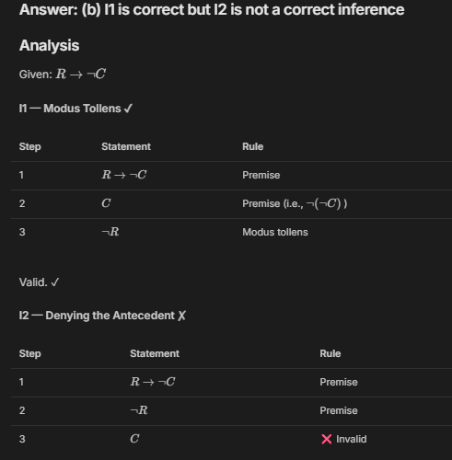
Rules of Inference in Propositional Logic
Building Arguments using Rules of Inference
Consider the following logical inferences.
I1: If it rains then the cricket match will not be played.
The cricket match was played.
Inference: There was no rain.
I2: If it rains then the cricket match will not be played.
It did not rain.
Inference: The cricket match was played.
Which of the following is TRUE?
(a) Both I1 and I2 are correct inferences
(b) I1 is correct but I2 is not a correct inference
(c) I1 is not correct but I2 is correct inference
(d) Both I1 and I2 are not correct inferences
Let R = it rains
C = the cricket match was played.
✅

Slide 74
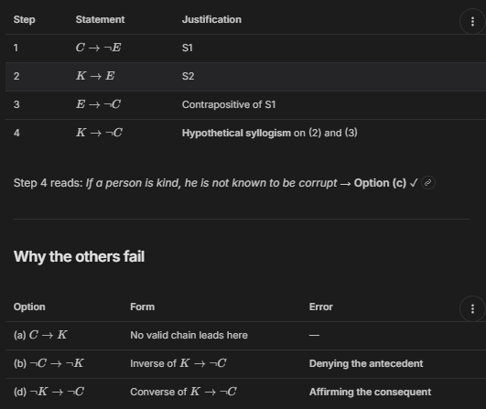
Rules of Inference in Propositional Logic
Building Arguments using Rules of Inference
Consider the following two statements.
S1: If a candidate is known to be corrupt, then he will not be elected.
S2: If a candidate is kind, he will be elected.
Which one of the following statements follows from S1 and S2 as per sound inference rules of logic?
(a) if a person is known to be corrupt, he is kind.
(b) if a person is not known to be corrupt, he is not kind.
(c) if a person is kind, he is not known to be corrupt.
(d) if a person is not kind, he is not known to be corrupt.
[GATE 2015 (set-2): 1 Mark]
Let C = candidate is corrupt,
E = candidate will be elected and
K = candidate is kind.
✅

Slide 75
Limitation of Propositional Logic
The argument which propositional logic can handle
If it snows today, then we will go skiing. Let p denotes "it is snowing today."
It is snowing today. q denotes "We will go skiing."
──────────────────────
∴ We will go skiing. Valid argument as it is true by the rule of Modus ponens.
The argument which propositional logic could not handle
Everyone enrolled in the university has lived in a dormitory.
Mia has never lived in a dormitory.
──────────────────────────────────
∴ Mia is not enrolled in the university.
No Rules of propositional logic allow us to conclude the truth of r.
Therefore, we need a more powerful type of logic called First Order Logic or Predicate Logic.

Slide 76
First Order Logic or Predicate Logic
Predicates
The statements involving variables which are neither True nor False until or unless the values of the variables are specified.
x is an animal x is greater than 3 x is less than 4 x + y = 7
All these statements are neither True nor False, and are not propositions.
In Predicate Logic, a statement is divided into two parts: Subject & Predicate
"x is an animal".
x is a subject (something we are discussing about).
"is an animal" is a predicate (refers to a property that the subject of the statement can have).
The statement "x is greater than 3" can be represented by G(x)
where G() denotes the predicate "is greater than 3" and x denotes the subject or variable.
After assigning the value of a variable x, the statement G(x) becomes a proposition and has a truth value (either T or F)
G(5) = 5 is greater than 3 → True
G(3) = 3 is greater than 3 → False

Slide 77
First Order Logic or Predicate Logic
Finding truth values of Predicates
Let P(x) denotes the statement "x > 3". What are the truth values of P(4) and P(2)?
P(x): x > 3 P(4): 4 > 3 (True) P(2): 2 > 3 (False)
Let P(x) denotes the statement "the word x contains the letter 'a'." What are the truth values of P(Orange), P(Lemon), P(True) and P(False)?
P(x): the word x contains the letter 'a'.
P(Orange): the word Orange contains the letter 'a'. (True)
P(Lemon): the word Lemon contains the letter 'a'. (False)
P(True): the word True contains the letter 'a'. (False)
P(False): the word False contains the letter 'a'. (True)
Let Q(x, y) denote "x is the capital of y". What are the truth values of Q(Delhi, India), Q(New York, New York), and Q(Denver, Colorado)?
If P(x) denotes x < 4, then what are the truth values of P(0), P(6), and P(10)?

Slide 78
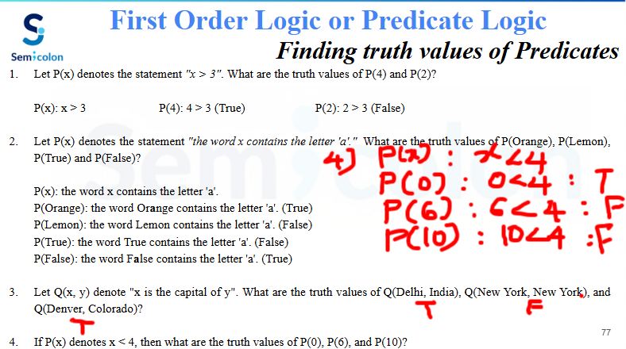

Slide 79
First Order Logic or Predicate Logic
Quantifiers
Words that refer to quantities such as "some" or "all".
It tells for how many elements a given predicate is True.
In English, Quantifiers are used to express the quantities without giving an exact number.
Ex: all, some, many, none, few etc. "Can I have some water?" "Jack has many friends here."
Types of Quantifiers
Universal Quantifier | Existential Quantifier
Domain of Discourse: Domain of x is set of all +ve integers A domain specifies the possible values of the variable under consideration. Without domain, there is no quantification.
Universal Quantification of P(x) is the statement “P(x) for all values of x in the domain.” Let P(x) be the statement: x + 1 > x P(1): 1 + 1 > 1 → 2 > 1 (True) P(2): 2 + 1 > 2 → 3 > 2 (True) …….. P(x) is true for all +ve integers x. ∀x P(x): For all x, P(x) is true under the domain of +ve integers. for all x P(x), for every x P(x), for each x P(x), for any x P(x), all of x P(x) ∀ = "for all" | Existential Quantification of Q(x) is the statement “There exists an element x in the domain such that Q(x).” Let Q(x) be the statement: x < 2 Q(1) : 1 < 2 (True) Q(2) : 2 < 2 (False) ……………. Is there some value of x for which Q(x) is True? Yes. Q(x) is true for x=1. Therefore, there is an x for which Q(x) is True. ∃x Q(x) — There exists some x for which Q(x) is true. there is an x such that Q(x), there is atleast one x such that Q(x), for some x P(x) ∃ = "There exists"

Slide 80
First Order Logic or Predicate Logic
Universal Quantifiers
When does ∀x P(x) become False?
∀x P(x) becomes False, when P(x) is not always True in the domain under consideration.
Let P(x) be the statement "x < 4". What is the truth value of the quantification ∀x P(x) where the domain consists of all +ve integers?
Finding just one counter example is enough to make ∀x P(x) False.
P(5): 5 < 4 (False)
As P(5) is False. Therefore, x = 5 is one such counterexample for the statement ∀x P(x).
This shows that P(x) is not True for every x in the domain of +ve integers.
Let Q(x) be the statement "x + 1 > 2x". If the domain consists of all integers, what is the truth value of ∀x Q(x)?
Q(1): 1 + 1 > 2(1) → 2 > 2 (False)
Since Q(1) is False, ∀x Q(x) is False.
If R(x) is the statement "x² ≥ 0", S(x) is the statement "x² ≥ x", and T(x) is the statement "x² < 0", determine the truth values of ∀x R(x), ∀x S(x) and ∀x T(x) if the domain of each variable consists of all integers.

Slide 81
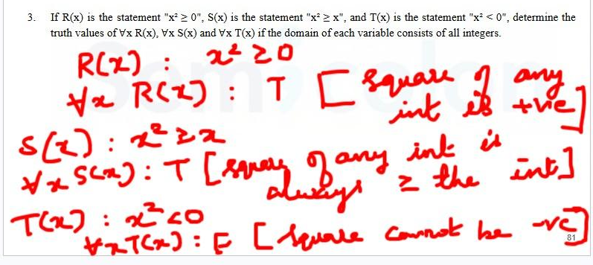
First Order Logic or Predicate Logic
Universal Quantifiers

Slide 82
First Order Logic or Predicate Logic
Expressing Quantifications in English
Let P(x) be the statement "x spends more than five hours every weekday in class." where the domain for x consists of all students. Express ∀x P(x) in English.
For every x in the domain of all students, x spends more than five hours every weekday in class.
Every student spends more than five hours every weekday in class.
Let N(x) be the statement "x has visited North Korea" where the domain consists of the students in your school. Express ∀x N(x) in English.
For every x in the domain of the students in your school, x has visited North Korea.
All students in your school have visited North Korea.
What does the statement ∀x P(x) mean if P(x) is "x is perfect" and the domain consists of people in your locality?
For every person in your locality, that person is perfect.
All people in your locality are perfect.

Slide 83
First Order Logic or Predicate Logic
Existential Quantifiers
What is the truth value of ∃x P(x), where P(x) is the statement "x² > 10" and the universe of discourse consists of the positive integers not exceeding 4? P(x): x² > 10, Domain: {1, 2, 3, 4}
Let P(x) be the statement "x = x²". If the domain consists of the integers. What is the truth value of ∃x P(x)?
P(1) : 1 = 1² (True) .
So, the truth value of ∃x P(x) is True
Let Q(x) be the statement "x + 1 > 2x". If the domain consists of all integers, What is the truth value of ∃x Q(x)?
Q(x) : x + 1 > 2x
Q(−1) : −1 + 1 > 2(−1) ⇒ 0 > −2 (True)
So, ∃x Q(x) is True.
Determine the truth value if the domain consists of all real numbers.
a) ∃x (x³ = −1) b) ∃x (x⁴ < x²)
Let x = −1 Let x = 1/2
(−1)³ = −1 → True (1/2)⁴ < (1/2)² ⇒ 1/16 < 1/4 → True
So, ∃x (x³ = −1) is True. So, ∃x (x⁴ < x²) is True.
d) ∃x (x² = −1) e) ∃x (x² < 0)
For any real number x, x² ≥ 0. For any real number x, x² ≥ 0.
There is no real number whose square is negative. Square can never be negative.
So, ∃x (x² = −1) is False. So, ∃x (x² < 0) is False.
x | P(x) | Truth Value
1 | 1² > 10 → 1 > 10 | False
2 | 2² > 10 → 4 > 10 | False
3 | 3² > 10 → 9 > 10 | False
4 | 4² > 10 → 16 > 10 | True
∃x P(x) = P(1) ∨ P(2) ∨ P(3) ∨ P(4)
Since P(4) is True, ∃x P(x) is True.
c) ∃x (x² = 2)
Let x = √2
(√2)² = 2 → True
So, ∃x (x² = 2) is True.

Slide 84
First Order Logic or Predicate Logic
Quantifiers with Restricted Domain
We can limit the domain of the quantifier by modifying the notation a bit.
∀x < 0 (x² > 0) Domain: Real Numbers
∀x < 0 (x² > 0) true
Meaning: The Square of a negative real number is positive.
Standard Form: ∀x < 0 (x² > 0) ⇔ ∀x (x < 0 → x² > 0)
∃y > 0 (y² = 2) Domain: Real Numbers
∃y > 0 (y = √2) true.
Meaning: There exists a positive square root of 2.
Standard Form: ∃y > 0 (y² = 2) ⇔ ∃y (y > 0 ∧ y² = 2)
What is the truth value of ∀x < 0 (x² = 1) where the domain consists of all real numbers?
Standard form: ∀x (x < 0 → x² = 1)
Counterexample: Let x = −2. Then x < 0 is True, but x² = 4 ≠ 1.
∀x < 0 (x² = 1) False.
What is the truth value of the following statements if the domain consists of all integers?
∃x ≠ 2 (x² = 4)
Standard form: ∃x (x ≠ 2 ∧ x² = 4)
Let x = −2 (−2) ≠ 2 and (−2)² = 4
∃x ≠ 2 (x² = 4) True.
∃x (x < 0 → x² − 2 ≥ 1)
The implication is false only when x < 0 is True AND x² − 2 ≥ 1 is False (i.e., x² < 3).
For integers: x = −1 gives x² = 1 < 3, so the implication fails at x = −1.
But we only need one x where it's true. Let x = 0:
x < 0 is False → implication is True
∃x (x < 0 → x² − 2 ≥ 1) is True. ✓

Slide 85
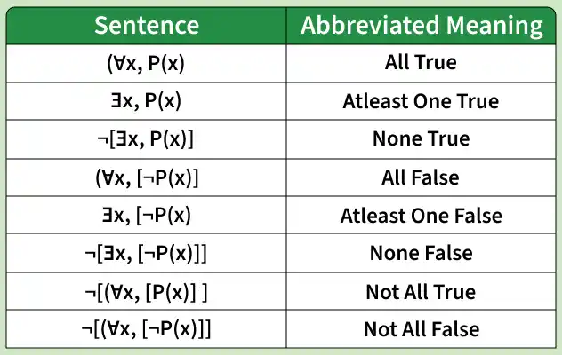
First Order Logic or Predicate Logic
Common Quantifier Meanings

Slide 86
Predicates vs Quantifiers
Predicate | Quantifier
A statement containing variables | A symbol indicating the scope of the predicate
Describes a property or relation | Specifies the extent to which the predicate is true
P(x): "x is an even number." | ∀: "For all" or ∃: "There exists"
No specific symbol | ∀ (Universal), ∃ (Existential)
Used to form logical statements | Used to quantify logical statements
Alone or with quantifiers | Always used with predicates
P(x), Q(x, y) | ∀x, ∃y
P(x): "x is an even number." | ∀ x ∈N ,P(x) : "For all x in natural numbers, x is even."
Describes properties of individual elements | Extends predicates over a range of elements

Slide 87
Predicates & Quantifiers
Applications in Computer Science
Program Verification:
Used to prove that a program works correctly for all possible inputs and satisfies its specifications.
Databases & Query Languages:
Predicates are used in conditions (WHERE clause), while quantifiers like EXISTS and ALL help filter and retrieve data logically.
Artificial Intelligence (AI):
Helps represent facts, rules, and relationships in knowledge-based systems for logical reasoning and decision-making.
Algorithms and Data Structures:
Used to define preconditions, postconditions, and constraints to ensure algorithm correctness and efficiency.
Compiler Design and Static Analysis:
Compilers use predicates to detect syntax errors, type mismatches, and rule violations before program execution.

Slide 88
Predicates & Quantifiers
Logical Equivalences
Two logical statements involving predicates and quantifiers are said to be equivalent
if and only if they have the same truth value in all the possible cases.
Logical equivalence is helpful in replacing one expression with an equivalent expression.
Universal quantifier distributes over conjunction: ∀x (P(x) ∧ Q(x)) ≡ ∀x P(x) ∧ ∀x Q(x)
Domain: All students of xyz university.
P(x): x has studied discrete mathematics.
Q(x): x has scored more than 60% marks in exam.
∀x (P(x) ∧ Q(x)): Every student in the xyz university has studied discrete mathematics and has scored more than 60% marks in exam.
∀x P(x) ∧ ∀x Q(x): Every student in the xyz university has studied discrete mathematics and every student in the xyz university has scored more than 60% marks in exam.
∀x (P(x) ∧ Q(x)) ≡ ∀x P(x) ∧ ∀x Q(x) → True
∀x (P(x) ∨ Q(x)) ≡ ∀x P(x) ∨ ∀x Q(x) → False
Discrete Math >60%
Mark ✓ ✓
Joe ✓ ✓
Discrete Math >60%
Mark ✓ ✗
Joe ✗ ✓

Slide 89
Predicates & Quantifiers
Logical Equivalences
Existential quantifier distributes over disjunction: ∃x (P(x) ∨ Q(x)) ≡ ∃x P(x) ∨ ∃x Q(x)
Domain: All students of xyz university.
P(x): x has studied discrete mathematics.
Q(x): x has scored more than 60% marks in exam.
∃x (P(x) ∨ Q(x)): Some students in the xyz university has studied discrete mathematics or has scored more than 60% marks in exam.
∃x P(x) ∨ ∃x Q(x): Some student in the xyz university has studied discrete mathematics or some student in the xyz university has scored more than 60% marks in exam.
∃x (P(x) ∨ Q(x)) ≡ ∃x P(x) ∨ ∃x Q(x) → True
∃x (P(x) ∧ Q(x)) ≡ ∃x P(x) ∧ ∃x Q(x) → False
Discrete Math >60%
Mark ✓ ✗
Joe ✗ ✗
Discrete Math >60%
Mark ✗ ✗
Joe ✗ ✓
Discrete Math >60%
Mark ✓ ✓
Joe ✗ ✗
Discrete Math >60%
Mark ✓ ✗
Joe ✗ ✓

Slide 90
Predicates & Quantifiers
Negating Quantified Expression
"Every student in the xyz university has studied discrete mathematics." ∀x P(x)
Domain: All students of xyz university. P(x): x has studied discrete mathematics.
Negation:
"It is not the case that every student in the xyz university has studied discrete mathematics." ¬∀xP(x)
"There is some student in the xyz university who has not studied discrete mathematics." ∃x¬P(x)
"There is a student in the xyz university who has studied discrete mathematics." ∃x P(x)
Domain: All students of xyz university. P(x): x has studied discrete mathematics.
Negation:
"It is not the case that there is a student in the xyz university who has studied discrete mathematics." ¬∃xP(x)
"Every student in the xyz university has not studied discrete mathematics." ∀x¬P(x)
De Morgan’s Laws for Quantifiers
¬∀xP(x)≡∃x¬P(x) ¬∃xP(x)≡∀x¬P(x)

Slide 91
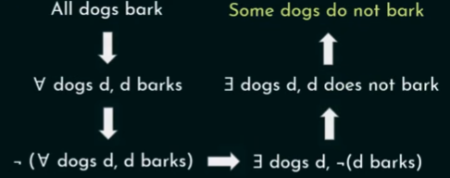
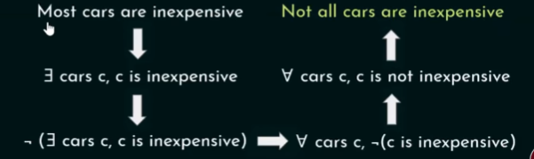
Predicates & Quantifiers
Negating
Quantified Expression
All dogs have fleas.
Some dog does not have fleas.
There is a horse that can add.
No horse can add.
No rabbit knows calculus.
Some rabbit knows calculus.
Original | Negation
"All A are B" | "Some A is not B"
"Some A is B" | "No A is B"
"No A is B" | "Some A is B"

Slide 92
Predicates & Quantifiers
Translating English Sentences to Logical Expressions
"Every student of XYZ University has studied discrete mathematics."
Let us suppose that the domain consists of all students of XYZ University.
And, S(x) denotes "x has studied discrete mathematics."
"For every student x in the XYZ University, x has studied discrete mathematics." ∀x S(x)
Suppose we use a different domain and a set of predicates: Domain: All people on the planet earth.
P(x) denotes "person x is a student in the XYZ University." S(x) denotes "person x has studied discrete mathematics."
"For every person x, if person x is a student in the XYZ University then x has studied discrete mathematics."
∀x (P(x) → S(x))
Note: We can't write ∀x (P(x) ∧ S(x)) because this statement says that "All people are students in the XYZ University and has studied discrete mathematics."
Using a two-variable predicate S(x, y) which represents the statement "person x has studied subject y."
∀x (P(x) → S(x, discrete mathematics)) under the domain of all people on the planet earth.
∀x (S(x, discrete mathematics)) — under the domain of all students of XYZ University.

Slide 93
Predicates & Quantifiers
Translating English Sentences to Logical Expressions
"Some student in the XYZ University has studied discrete mathematics."
Let us suppose that the domain consists of all students of XYZ University. P(x) denotes "x has studied discrete mathematics."
"There exists some student x in the XYZ University who has studied discrete mathematics." ∃x P(x)
Suppose we use a different domain and a set of predicates: Domain: All people on the planet earth.
S(x) denotes "x is a student of XYZ University." P(x) denotes "x has studied discrete mathematics."
"There is some person x, such that x is the student of XYZ University and x has studied discrete mathematics." ∃x (S(x) ∧ P(x))
“There is a student who has taken more than 21 credit hours in a semester and received all A’s”
Premises: “All lions are fierce” “Some lions do not drink coffee”
Conclusion: “Some fierce creatures do not drink coffee” Domain: All creatures
Predicates: P(x): “x is a lion” Q(x): “x is fierce” R(x): “x drinks coffee”
Premises: “All humming birds are richly colored” “No large birds live on honey”
“Birds that do not live on honey are dull in color”
Conclusion: “Humming birds are small” Domain: All birds
Predicates: P(x): “x is a humming bird” Q(x): “x is large” R(x): “x lives on honey” S(x): “x is richly colored”

Slide 94
Predicates & Quantifiers
Translating English Sentences to Logical Expressions
What is the logical translation of the following statement? "None of my friends are perfect." [GATE CS 2013]
(A) ∃x(F(x) ∧ ¬P(x)) (B) ∃x(¬F(x) ∧ P(x)) (C) ∃x(¬F(x) ∧ ¬P(x)) (D) ¬∃x(F(x) ∧ P(x))
Domain: All people in this world. F(x): "x is my friend." P(x): "x is perfect."
"None of my friends are perfect.": ∀x(F(x) → ¬P(x)) ≡ ∀x(¬F(x) ∨ ¬P(x)) ≡ ∀x¬(F(x) ∧ P(x)) ≡ ¬∃x(F(x) ∧ P(x))
Which one of the following is NOT logically equivalent to ~∃x(∀y(α) ∧ ∀z(β))? [GATE CS 2013]
(A) ∀x(∃z(~β) → ∀y(α)) (B) ∀x(∀z(β) → ∃y(~α)) (C) ∀x(∀y(α) → ∃z(~β)) (D) ∀x(∃y(~α) → ∃z(~β))
~∃x(∀y(α) ∧ ∀z(β)) ≡ ∀x~(∀y(α) ∧ ∀z(β)) ≡ ∀x(~∀y(α) ∨ ~∀z(β)) ≡ ∀x(∃y(~α) ∨ ∃z(~β))
(A) ∀x(∃z(~β) → ∀y(α)) ≡ ∀x(~∃z(~β) ∨ ∀y(α)) ≡ ∀x(∀z(β) ∨ ∀y(α))
(B) ∀x(∀z(β) → ∃y(~α)) ≡ ∀x(~∀z(β) ∨ ∃y(~α)) ≡ ∀x(∃z(~β) ∨ ∃y(~α))
(C) ∀x(∀y(α) → ∃z(~β)) ≡ ∀x(~∀y(α) ∨ ∃z(~β)) ≡ ∀x(∃y(~α) ∨ ∃z(~β))
(D) ∀x(∃y(~α) → ∃z(~β)) ≡ ∀x(~∃y(~α) ∨ ∃z(~β)) ≡ ∀x(∀y(α) ∨ ∃z(~β))

Slide 95
Predicates & Quantifiers
Translating English Sentences to Logical Expressions
What is the correct translation of the following statement? "Some real numbers are rational" Domain: All numbers
∃x(real(x) ∨ rational(x)) ∀x(real(x) → rational(x)) ∃x(real(x) ∧ rational(x)) ∃x(rational(x) → real(x))
(A) There exist some numbers which are either real or rational. [GATE CS 2012]
(B) All real numbers are rational.
(C) There exist some numbers which are both real and rational.
(D) There exist some numbers such that if they are rational then they are real.
"Gold and silver ornaments are precious". Domain: All ornaments. [GATE CS 2009]
G(x): x is a gold ornament S(x): x is a silver ornament P(x): x is precious
∀x(P(x) → (G(x) ∧ S(x))) ∀x((G(x) ∧ S(x)) → P(x)) ∃x((G(x) ∧ S(x)) → P(x)) ∀x((G(x) ∨ S(x)) → P(x))
(A) For all ornaments x, if x is precious then it is both gold and silver.
(B) For all ornaments x, if x is both gold and silver then it is precious.
(C) For some ornaments x, if x is both gold and silver then it is precious.
(D) For all ornaments x, if x is either gold or silver then it is precious.

Slide 96
Predicates & Quantifiers
Translating English Sentences to Logical Expressions
Let Graph(x) be a predicate which denotes that x is a graph. Let Connected(x) be a predicate which denotes that x is connected. Which of the following first order logic sentences DOES NOT represent the statement:
'Not every graph is connected'?
(A) ¬∀x( Graph(x) ⇒ Connected(x)) (B) ∃x( Graph(x) ∧ ¬Connected(x))
(C) ¬∀x(¬Graph(x) ∨ Connected(x)) (D) ∀x( Graph(x) ⇒ ¬Connected(x)) [GATE CS 2007]
Solution: "Not every graph is connected" is equivalent to "There is at least one graph which is not connected."
(A) ¬∀x( Graph(x)⇒ Connected(x)) represents "It is not the case that for all x, if x is a graph, then it is connected."
OR "It is not the case that every graph is connected."
(B) ∃x( Graph(x)∧ ¬Connected(x)) represents "There exists some x such that x is a graph and x is not connected."
OR "There exists some graph which is not connected."
(C) ¬∀x(¬ Graph(x)∨ Connected(x)) can be rewritten as ∃x( Graph(x)∧ ¬Connected(x))
(D) ∀x( Graph(x)⇒ ¬Connected(x)) represents "For all x, if x is a graph then it is not connected."
OR "Every graph is not connected."

Slide 97
Predicates & Quantifiers
Translating English Sentences to Logical Expressions
The CORRECT formula for the sentence, "not all rainy days are cold" is [GATE CS 2014 (Set 3)]
∀d(Rainy(d) ∧ ¬Cold(d)) ∀d(¬Rainy(d) → Cold(d)) ∃d(¬Rainy(d) → Cold(d)) ∃d(Rainy(d) ∧ ¬Cold(d))
Solution: "Not all rainy days are cold" can be rewritten as "Some rainy days are not cold"
"Not all rainy days are cold" ≡ ¬∀d(Rainy(d) → Cold(d)) ≡ ∃d¬(Rainy(d) → Cold(d))
≡ ∃d¬(¬Rainy(d) ∨ Cold(d)) ≡ ∃d(Rainy(d) ∧ ¬Cold(d))
English equivalents:
∀d(Rainy(d) ∧ ¬Cold(d)) → "Every day is rainy and not cold."
∀d(¬Rainy(d) → Cold(d)) → "If a day is not rainy, then it is cold." → "All non-rainy days are cold."
∃d(¬Rainy(d) → Cold(d)) → "There exists a day such that if it is not rainy, then it is cold."
∃d(Rainy(d) ∧ ¬Cold(d)) → "There exists a day that is rainy and not cold."
"Some boys in the class are taller than all the girls" Note: taller(x,y) is true if x is taller than y. [GATE CS 2004]
(A) (∃x)(boy(x)→(∀y)(girl(y)∧taller(x,y))) (B) (∃x)(boy(x)∧(∀y)(girl(y)∧taller(x,y)))
(C) (∃x)(boy(x)→(∀y)(girl(y)→taller(x,y))) (D) (∃x)(boy(x)∧(∀y)(girl(y)→taller(x,y)))
For universal quantifiers, we use implication and for existential quantifiers, we use conjunction.

Slide 98
Predicates & Quantifiers
Translating English Sentences to Logical Expressions
Tigers and lions attack if they are hungry or threatened. [GATE CS 2006]
(A) ∀x[(tiger(x) ∧ lion(x)) → (hungry(x) ∨ threatened(x)) → attacks(x)]
(B) ∀x[(tiger(x) ∨ lion(x)) → (hungry(x) ∨ threatened(x)) ∧ attacks(x)]
(C) ∀x[(tiger(x) ∨ lion(x)) → attacks(x) → (hungry(x) ∨ threatened(x))]
(D) ∀x[(tiger(x) ∨ lion(x)) → (hungry(x) ∨ threatened(x)) → attacks(x)]
(A) tiger(x) ∧ lion(x): an animal is both tiger and lion.
(B) ∀x[(tiger(x)∨lion(x))→(hungry(x)∨threatened(x))∧attacks(x)]
"For all animals x, if x is either tiger or lion, then they are hungry or threatened, and they attack."
OR "All lions and tigers are hungry or threatened, and attacks."
(C) ∀x[(tiger(x)∨lion(x))→attacks(x)→(hungry(x)∨threatened(x))]
"For all animals x, if x is either tiger or lion, then if they attack, then they are hungry or threatened."
OR "All tigers and lions are hungry or threatened if they attack."
(D) ∀x[(tiger(x)∨lion(x))→(hungry(x)∨threatened(x))→attacks(x)]
"All tigers and lions attack if they are hungry or threatened."

Slide 99
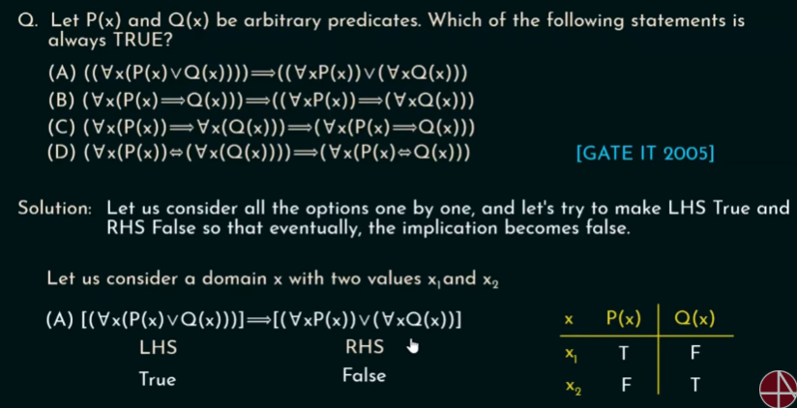
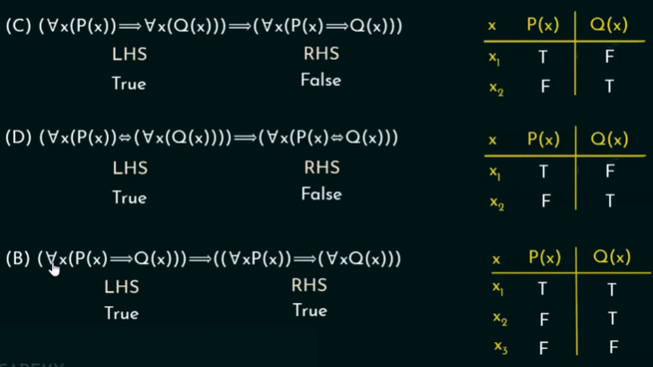
Predicates & Quantifiers
Translating English Sentences to Logical Expressions
If T(x) denotes x is a trigonometric function, P(x) denotes x is a periodic function, then the statement "It is not the case that some trigonometric functions are not periodic" can be logically represented as [ISRO CS 2017]
(A) ¬∃x[T(x)∧¬P(x)] (B) ¬∃x[T(x)∨¬P(x)] (C) ¬∃x[¬T(x)∧¬P(x)] (D) ¬∃x[T(x)∧P(x)]
(A) It is not the case that there exist some function which is trigonometric and not periodic.
(B) It is not the case that there exist some function which is trigonometric or not periodic.
(C) It is not the case that there exist some function which is not trigonometric and not periodic.
(D) It is not the case that there exist some function which is trigonometric and periodic.

Slide 100
Nested Quantifiers
Two quantifiers are said to be nested if one is within the scope of the other.
∀x∃y Q(x,y): ∃ is within the scope of ∀.
Anything within a scope of the quantifier can be thought of as a propositional function.
∀x∃y Q(x,y) can be written as ∀xP(x) where P(x): ∃y Q(x,y)
Different Combinations of Nested Quantifiers
∀x∀y Q(x, y) ∃x∃y Q(x, y) [Order of quantifiers doesn't matter]
∀x∃y Q(x, y) ∃y∀x Q(x, y) [Order of quantifiers does matter]
∀x∀y Q(x, y) ≡ ∀y∀x Q(x, y)
∃x∃y Q(x, y) ≡ ∃y∃x Q(x, y)
∀x∃y Q(x, y) ≠ ∃y∀x Q(x, y)

Slide 101
Nested Quantifiers
Let x and y be real numbers. P(x,y): x+y=0. Find the truth values of
∀x∀y P(x, y) ∀x∃y P(x, y) ∃y∀x P(x, y) ∃x∃y P(x, y)
For all real numbers x and y, x+y=0-------------------F
For every real number x, there exist a real number y such that x+y=0--------------------T
There exist some real number y such that for every real number x, x+y=0--------------------F
There exist some real numbers x and y such that x+y=0------------------------------------T
Let x and y be real numbers. Q(x,y): x.y=0. Find the truth values of
∀x∀y Q(x, y) ∀x∃y Q(x, y) ∃y∀x Q(x, y) ∃x∃y Q(x, y)
For all real numbers x and y, x.y=0-------------------F
For every real number x, there exist a real number y such that x.y=0--------------------T
There exist some real number y such that for every real number x, x.y=0--------------------T
There exist some real numbers x and y such that x.y=0------------------------------------T
Let Q(x,y,z): x+y=z. Domain: Real numbers. Find the truth values of ∀x∀y∃z Q(x, y, z) ∃z∀x∀y Q(x, y, z)
For all real numbers x and y, there is a real number z such that x+y=z-------------------T
There exist some real number z such that for all real numbers x and y, x+y=z--------------------F

Slide 102
Nested Quantifiers
Translating English Sentences
Steps:
Read and understand the given english statement.
Find the domain of discourse according to the statement.
Find the associated quantifiers.
Rewrite the statement so that the domain of discourse and quantifiers are properly visible.
Finally, introduce the variables in the statement.
A negative real number does not have a square root that is a real number.
Domain: All real numbers.
Quantifier: ∀ [All negative real numbers], ∃ [A square root]
For all real numbers, if a real number is negative then its square root is not real.
Variables: Two real numbers x and y.
For all real numbers x, if x is negative then it is not the case that there exist some real number y such that x = y².
∀x ((x<0) → ¬∃y (x = y²))
The sum of two positive integers is always positive.
Domain: All integers.
Quantifier: For all (∀)
For every two integers, if the two integers are positive then their sum is also positive.
Variables: Two integers x and y.
For every two integers x and y, if x and y are positive then x=y is also positive.
∀x∀y (((x>0) ∧ (y>0)) → (x+y>0))

Slide 103
Nested Quantifiers
Translating English Sentences
Every student of XYZ University has a computer or has friend who has a computer.
Domain: Students of XYZ University. Predicates: C(x): x has a computer. F(x,y): x is a friend of y
Quantifier: For all (∀) students, there exist (∃) a friend Variables: Students x and y.
For all students x at XYZ University, x has a computer or there exist some y such that y has a computer and x and y are friends.. ∀x (C(x) ∨ ∃y (C(y) ∧ F(x, y)))
"Every teacher is liked by some student." [GATE CS 2005]
(A) ∀(x) [teacher(x) → ∃(y) [student(y) → likes(y,x)]] (B) ∀(x) [teacher(x) → ∃(y) [student(y) ∧ likes(y, x)]]
(C) ∃(y) ∀(x) [teacher(x) → [student(y) ∧ likes(y, x)]] (D) ∀(x) [teacher(x) ^ ∃(y) [student(y) → likes(y, x)]]
(A) For all x, if x is a teacher then there exist some y such that if y is a student then y likes x.
(B) For all x, if x is a teacher then there exist some y such that y is a student and y likes x.
∀(x) ∃(y) [teacher (x) → [student (y) ∧ likes (y, x)]]
(C) There exist some y such that for every x, if x is a teacher then y is a student and y likes x.
Some student likes all teachers.
(D) For all x, x is a teacher and there exist y such that if y is a student then y likes x.
Everyone is a teacher.

Slide 104
Nested Quantifiers
Translating English Sentences
Everyone has exactly one best friend
Domain consisting of all people
Let us suppose that B(x,y) denotes "y is the best friend of x."
"Everyone has exactly one best friend" —-----> ∀x(x has exactly one best friend)
∀x∃y(B(x, y)) —----------> "For every x, there exist some y such that y is the best friend of x.
There could be more than one best friend of x, according to this expression.
Suppose that y is the best friend and there is no person in the world other than y who is the best friend of x.
Let’s denote these people by z.
∀z ((z ≠ y) → ¬B(x, z)) —--------> All people in this world other than y are not best friends of x.
Complete expression —---------> ∀x∃y (B(x, y) ∧ ∀z ((z ≠ y) → ¬B(x, z))) —------> ①
Note: We can also use ∃! which is the uniqueness quantifier to represent exactly one.
∴ we can replace expression 1 by ∀x∃!y (B(x, y)) —----------> ②

Slide 105
Negating Nested Quantifiers
Negation of ∃x P(x): ¬∃x P(x) ≡ ∀x ¬P(x) Negation of ∀x P(x): ¬∀x P(x) ≡ ∃x ¬P(x)
Negating nested quantifier is as simple as negating single quantifier.
Successively apply the rules of negating single quantifiers to nested quantifiers.
Move the negation inside quantifiers by applying De Morgan's laws for negating single quantifiers.
According to De Morgan's law, ∀ will get converted to ∃ and ∃ will get converted to ∀.
Express the negation of the statement ∀x∃y (xy = 1) so that no negation precedes a quantifier.
¬∀x∃y (xy = 1) ≡ ∃x¬∃y (xy = 1) ≡ ∃x∀y ¬(xy = 1) ≡ ∃x∀y (xy ≠ 1)
Express the statement "Someone has visited every country in the world except Libya" using quantifiers. Then form the negation of the statement so that no negation is to the left of a quantifier. Next, express the negation in simple English. (Do not simply use the words "It is not the case that.")
Let V(x, y) denotes x has visited country y. Domain of x: "all people" Domain of y: "all countries”
"Someone has visited every country except Libya": ∃x∀y (V(x, y) ↔ y ≠ Libya)
Negation:: ∀x∃y (V(x, y) ↔ y = Libya) since ¬(p↔q) = (p↔¬q)
Every person has visited Libya or Every person has not visited any other country except Libya.

Slide 106
Negating Nested Quantifiers
Express the statement "No one has climbed every mountain in the Himalayas" using quantifiers. Then, form the negation of the statement so that no negation is to the left of a quantifier. Next, express the negation in simple English. (Do not use the words "It is not the case that.")
Let C(x, y) denotes "x has climbed mountain y in the Himalayas."
"No one has climbed every mountain in the Himalayas": ¬∃x∀y C(x, y)
Negation:: ¬(¬∃x∀y C(x, y)) ≡ ∃x∀y C(x, y)
There exist some person who has climbed every mountain in the Himalayas.
Express the negation of the proposition "There is a student in this class who has taken every mathematics course offered at this school" using quantifiers, and in English.
T(x, y) = "x has taken mathematics course y"
Original statement: ∃x∀yT(x,y)
Negation: ¬∃x∀yT(x,y) ≡ ∀x∃y¬T(x,y)
"Every student in this class has skipped at least one mathematics course offered at this school."

Slide 107
The Resolution Principle
Used to prove whether an argument is correct or not.
Preliminaries:
Literal: A variable or negation of a variable.
Clause: Disjunction of literals.
Resolvant: For any two clauses C₁ and C₂, if C₁ has a literal L₁ and C₂ has L₂ which is the complement of L₁, then delete L₁ and L₂ from C₁ and C₂ and construct the disjunction of remaining literals. The result so obtained is called the resolvent C of C₁ and C₂.
Let C₁ = P ∨ Q ∨ R and C₂ = ¬P ∨ S ∨ T, then the resolvant of C₁ and C₂ = Q ∨ R∨ S ∨ T
Modus Ponens Rule: [P ∧ (P → Q)] → Q
C₁: P C₂: ¬P ∨ Q Resolvant C: Q (conclusion)
Modus Tollens Rule: [¬Q ∧ (P → Q)] → ¬P
C₁: ¬Q C₂: ¬P ∨ Q Resolvant C: ¬P (conclusion)

Slide 108
The Resolution Principle
Theorem: Given two clauses C₁ and C₂, a resolvant C of C₁ and C₂ is a logical consequence of C₁ and C₂.
Proof:
Consider two clauses C₁ and C₂. C₁: L ∨ C₁' C₂: ¬L ∨ C₂' Resolvant C: C₁’ ∨ C₂’
To prove C is the logical consequence of C₁ and C₂.
If C is logical consequence, then if C₁ and C₂ are true then C has to be true.
Assume that C₁ and C₂ are true. For L, there are two possibilities: L is either true or false.
Case 1: L is true. C₁ : L ∨ C₁' (True) C₂ : ¬L ∨ C₂' (True) C₂' has to be true.
This means C = C₁' ∨ C₂' is true because of C₂'
Case 2: L is false. C₁ : L ∨ C₁' (True) C₂ : ¬L ∨ C₂' (True) C₁' has to be true.
This means C = C₁' ∨ C₂' is true because of C₁'.
C is the logical consequence of C₁ and C₂.
Therefore, a resolvent C of C₁ and C₂ is a logical consequence of C₁ and C₂.

Slide 109
The Resolution Principle
How to prove whether an argument is valid
Consider an argument with premises P1, P2, ... , Pr and conclusion C.
To prove whether an argument is valid, put all premises in clause form and add ~C to it.
From the sequence, if □ (empty clause) can be derived, then the argument is valid.
Modus ponens rule: [P ∧ (P → Q)] → Q
In the clause form: C₁: P
C₂: ¬P ∨ Q
Take C₃ as negation of Q: C3 : ~Q
C₄ : Q (from C₁ and C₂ by resolution)
C₅ : □ (from C₃ and C₄ by resolution)
As an Empty clause is obtained. Therefore, the argument is valid.

Slide 110
The Resolution Principle
Use resolution to show that the hypothesis "Allen is a bad boy or Hillary is a good girl" and "Allen is a good boy or David is happy" imply the conclusion "Hillary is a good girl or David is happy."
Let b denotes "Allen is a good boy" g denotes "Hillary is a good girl"
h denotes "David is happy"
C₁: ¬b ∨ g C₂: b ∨ h C₃: ¬(g ∨ h) = ¬g ∧ ¬h
C₄: ¬g C₅: ¬h C₆: g ∨ h C₇: h C₈: □
Determine whether the below argument is valid.
If Superman were able to and willing to prevent evil, he would do so.
If Superman were unable to prevent evil, he would be impotent;
If he were unwilling to prevent evil, he would be malevolent.
Superman does not prevent evil.
If Superman exists, he is neither impotent nor malevolent.
Therefore, Superman does not exist.
p = "Superman is able to prevent evil"
q = "Superman is willing to prevent evil"
r = "Superman prevents evil"
s = "Superman is impotent"
t = "Superman is malevolent"
u = "Superman exists"
C₁: (p ∧ q) → r = ¬p ∨ ¬q ∨ r
C₂: ¬p → s = p ∨ s C₇: ¬q ∨ r ∨ s
C₃: ¬q → t = q ∨ t C₈: r ∨ s ∨ t
C₄: ¬r = ¬r C₉: s ∨ t
C₅: u → ¬(s ∧ t)
= ¬u ∨ ¬s ∨ ¬t C₁₀: ¬u
C₆: ¬u = ¬(¬u) = u C₁₁: □

Slide 111
Fallacies
There are some common arguments which are invalid. Though at first glance, they seem right. Such a type of argument is known as fallacy.
Fallacy of Affirming the Conclusion:
Example: [(p → q) ∧ q] → p
When p is false and q is true, p → q is true but conclusion is false. Therefore, p is not a logical consequence of p → q and q.
Example: If today is Monday, then John will go to work.
John will go to work.
Therefore, today is Monday.
Let p denotes "today is Monday"
and q denotes "John will go to work."
Fallacy of Denying Hypothesis:
Example: [(p → q) ∧ ¬p] → ¬q
When p is false and q is true, p → q and ¬p are true but ¬q is false.
Therefore, the argument is invalid.
Example:
If Socrates is human, then Socrates is mortal.
Socrates is not human
∴ Socrates is not mortal
Let p denotes "Socrates is human."
and q denotes "Socrates is mortal."

Slide 112
Rules of Inference for Quantified Statements
Universal Generalization: This rule states that ∀x P(x) is true, given the premise, P(c) is true for an arbitrary c.
P(c) for an arbitrary c
_________________
∴ ∀x P(x)
If P(c) holds for any arbitrary element c, then we can conclude ∀x P(x).
Justify that if ∀x(P(x) → Q(x)) and ∀x(Q(x) → R(x)) are true, then ∀x(P(x) → R(x)) is true, where the domain of all quantifiers are same.
Let c be some arbitrary element.
Premises: ∀x(P(x) → Q(x)) (1) ∀x(Q(x) → R(x)) (2)
By Universal Instantiation from (1) P(c) → Q(c) (3)
By Universal Instantiation from (2) Q(c) → R(c) (4)
Hypothetical Syllogism from (3) and (4) P(c) → R(c) (5)
By Universal Generalization from (5) ∀x(P(x) → R(x))
Universal Instantiation: This rule is used to conclude that P(c) is true when ∀x P(x) is true. ∀x P(x)
______
∴ P(c)
Determine whether the argument "All students in this class understand logic. David is a student in this class. Therefore, David understands logic." is correct or not.
P(x) denotes "x is a student in this class"
Q(x) denotes "x understands logic"
Premises: ∀x (P(x) → Q(x)) (1)
P(David) (2)
By Universal Instantiation from (1)
P(David) → Q(David) (3)
By Modus Ponens from (2) and (3) Q(David)

Slide 113
Rules of Inference for Quantified Statements
Existential Instantiation: This rule allows us to conclude that there is some element c for which P(c) is true when ∃xP(x) is true.
∃xP(x) [c cannot be arbitrary.]
______________
∴ P(c) for some c
Existential Generalization: This rule states that ∃xP(x) is true when for a particular element c, P(c) is true.
P(c) for some element c
──────────────
∴ ∃xP(x)
Show that if ∃x(P(x) ∧ Q(x)) is true then ∃xP(x) ∧ ∃xQ(x) is also true.
∃x(P(x) ∧ Q(x)) Premise
P(c) ∧ Q(c) Existential Instantiation from (1)
P(c) Simplification from (2)
∃xP(x) Existential Generalization from (3)
Q(c) Simplification from (2)
∃xQ(x) Existential Generalization from (5)
∃xP(x) ∧ ∃xQ(x) Conjunction from (4) and (6)
Universal Modus Ponens Rule: Combination of two rules: Universal Instantiation & Modus Ponens
If ∀x(P(x) → Q(x)) is true and P(c) is true for some element c in the domain of universal quantifier then Q(c) must also be true.
All men are mortal Socrates is a man ∴ Socrates is mortal
Let P(x) denotes "x is a man"and Q(x) denotes "x is mortal".
Premises: 1. ∀x(P(x) → Q(x)) 2. P(Socrates)
Universal Instantiation from (1): P(Socrates) → Q(Socrates)(3)
Modus ponens from (2) & (3). Q(Socrates)
Universal Modus Tollens Rule: Combines universal instantiation and modus Tollens.
If ∀x(P(x) → Q(x)) is true and ¬Q(c) is true, where c is the particular element in the domain the ¬P(c) must also be true.

Slide 114
Rules of Inference for Quantified Statements
All parrots like fruit
Charlie does not like fruit
∴ Charlie is not a parrot.
P(x): "x is a parrot" Q(x): "x likes fruit"
Premises:
∀x(P(x) → Q(x))
¬Q(Charlie)
P(Charlie) → Q(Charlie) Universal Instantiation
¬P(Charlie) Modus Tollens
For each of the following arguments, determine whether the argument is correct or not.
Every computer science major takes discrete mathematics course. Ria is taking discrete mathematics. Therefore, Ria is a computer science major.
Let P(x) = "x is a computer science major",
Q(x) = "x takes discrete mathematics"
Premises: ∀x(P(x) → Q(x)) (1) Q(Ria) (2)
Universal Instantiation from (1) : P(Ria) → Q(Ria) (3)
P(Ria) ← Cannot be derived from (2) and (3)
Ria could be taking discrete math for another reason. So by Fallacy of affirming the consequent, the argument is invalid.
Everyone who eats granola everyday is healthy. Linda is not healthy. Therefore, Linda does not eat granola every day.
Let P(x) = "x eats granola everyday" and Q(x) = "x is healthy"
Premises: ∀x(P(x) → Q(x)) (1) ¬Q(Linda) (2)
Universal Instantiation from (1): P(Linda) → Q(Linda) (3)
Modus Tollens from (2) and (3): ¬P(Linda)
Universal Modus Tollens, so the argument is valid.

Slide 115
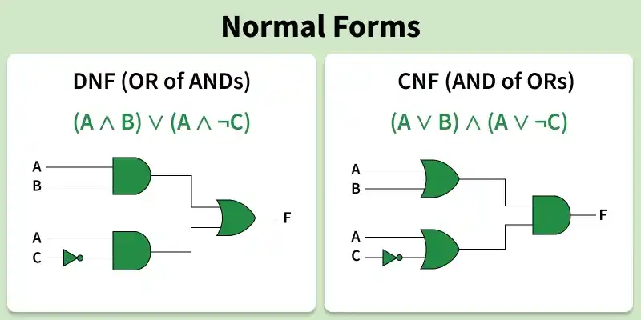
Normal Forms & Principal Forms
In propositional logic, complex logical statements are often converted into standard forms to simplify their analysis and manipulation. Normal forms and principal forms are the standardized ways of writing logical expressions so they are easier to analyze, compare, or implement.
Minterm: Conjunction (AND) of all variables in the expression, where each variable appears exactly once, either in its original form or negated (A ∧ B ∧ ¬C).
Maxterm: Disjunction (OR) of all variables in the expression, where each variable appears exactly once, either in its original form or negated (¬A ∨ B ∨ C).
Normal Forms: Structured representations of logical expressions where the formula is broken down into a combination of literals connected by logical operators such as AND, OR, and NOT.
Disjunctive Normal Form: A logical expression consisting of one or more conjunctions (AND) of literals joined together by disjunctions (OR).
Conjunctive Normal Form: logical expression consisting of one or more disjunctions (OR) of literals joined together by conjunctions (AND).

Slide 116
Normal Forms
If any elementary product in DNF is a tautology, then the given DNF is also a tautology.
(P ∧ ~ Q) ∨ (Q ∧ R) ∨ (~ P ∧ Q ∧~ R)
If every elementary sum in CNF is a tautology, then the given CNF is also a tautology.
(P~ ∨ Q) ∧ (Q ∨ R) ∧ (~ P ∨ Q ∨ ~ R)
The DNF & CNF of any formula are not unique.
Conversion to DNF
Eliminate Bi-conditional and Implication: Convert any bi-conditional and implication into their logical equivalents.
Move Negations Inward: Apply De Morgan’s laws to push negations inside and eliminate double negations.
Distribute AND over OR: Apply distributive laws to achieve a disjunction of conjunctions.
Convert (A ∨ B) ∧ (C ∨ D) to DNF:
(A ∨ B) ∧ (C ∨ D) = [(A ∨ B) ∧ C] ∨ [(A ∨ B) ∧ D]
= [(A ∧ C) ∨ (B ∧ C)] ∨ [(A ∧ D) ∨ (B ∧ D)​]
= (A ∧ C) ∨ (B ∧ C) ∨ (A ∧ D) ∨ (B ∧ D)
Conversion to CNF
Eliminate Bi-conditional and Implication: Convert any bi-conditional and implication into their logical equivalents.
Move Negations Inward: Apply De Morgan’s laws to push negations inside and eliminate double negations.
Distribute OR over AND: Apply distributive laws to achieve a conjunction of disjunctions.
Convert (A → B) ∧ ¬C to CNF:
(A → B) ∧ ¬C ⇒ (¬A ∨ B) ∧ ¬C

Slide 117
Principal Normal Forms
A Principal Form (PNF) is a canonical representation of a propositional formula in which every term contains all the variables of the expression exactly once, either in its original form or negated. Principal normal forms are constructed using minterms or maxterms obtained from the truth table of the logical expression.
Principal Disjunctive Normal Form (PDNF):
Sum-of-Products Canonical Form
A logical expression consisting of the disjunction (OR) of minterms only.
General Structure: m₁ ∨ m₂ ∨ ⋯ ∨ m_{n} , where each m_{i} is a minterm.
Eg: (P ∧ ~ Q ∧ ~ R) ∨ (P ∧ ~ Q ∧ R) ∨ (~ P ∧ ~ Q ∧ ~ R)
Conversion to PDNF
Construct the Truth Table: Write the truth table for the given logical expression.
Identify the True Rows: Select all rows where the expression evaluates to True.
Write the Corresponding Minterms: For each True row, write a minterm by:
Using the variable itself if its value is True.
Using its negation if its value is False.
Combine the Minterms: Join all the minterms using the OR operator.
Convert the expression A → B into PDNF.
p | q | p → q | Minterms
T | T | T | P ∧ Q
T | F | F | P ∧ ~ Q
F | T | T | ~ P ∧ Q
F | F | T | ~ P ∧ ~ Q
(P ∧ Q) ∨ (~ P ∧ Q) ∨ (~ P ∧ ~ Q)

Slide 118
Principal Forms
Dual of a minterm is called a maxterm.
Principal Conjunctive Normal Form (PCNF):
Product-of-Sums Canonical Form
A logical expression consisting of the conjunction (AND) of maxterms only.
General Structure: M₁∧ M₂ ∧ ⋯ ∧ M_{n} , where each M_{i} is a maxterm.
Eg: (P ∨ ~ Q ∨ ~ R) ∧ (P ∨ ~ Q ∨ R) ∧ (~ P ∨ ~ Q ∨ ~ R)
Conversion to PCNF
Construct the Truth Table: Write the truth table for the given logical expression.
Identify the False Rows: Select all rows where the expression evaluates to False.
Write the Corresponding Maxterms: For each False row, write a maxterm by:
Using the variable itself if its value is False.
Using its negation if its value is True.
Combine the Maxterms: Join all the maxterms using the AND operator.
Convert the expression A → B into PCNF.
p | q | p → q | Maxterms
T | T | T | ~ P ∨ ~ Q
T | F | F | ~ P ∨ Q
F | T | T | P ∨ ~ Q
F | F | T | P ∨ Q
~ P ∨ Q

Slide 119
Normal Forms
Convert (A ∨ B) ∧ (¬A ∨ C) to DNF
Distribute the AND over OR:
(A ∨ B) ∧ (¬A ∨ C)
= (A ∧ ¬A) ∨ (A ∧ C) ∨ (B ∧ ¬A) ∨ (B ∧ C)
Simplify:
(A ∧ C) ∨ (B ∧ ¬A) ∨ (B ∧ C)
Convert (A ∧ B) ∨ (¬A ∧ ¬B) to CNF
Distribute the OR over AND:
(A ∧ B) ∨ (¬A ∧ ¬B)
= (A ∨ ¬A) ∧ (A ∨ ¬B) ∧ (B ∨ ¬A) ∧ (B ∨ ¬B)
Simplify:
(A ∨ ¬B) ∧ (B ∨ ¬A)
Find the PDNF for A ∧ (¬B ∨ C)
Step 1: Expand
A∧(¬B∨C) = (A∧¬B)∨(A∧C)
Step 2: Add missing variables
A∧¬B=(A∧¬B∧C)∨(A∧¬B∧¬C)
A∧C=(A∧B∧C)∨(A∧¬B∧C)
Step 3: Collect and remove duplicates.
(A∧B∧C)∨(A∧¬B∧C)∨(A∧¬B∧¬C)
Properties
Logical Equivalence: Ensures that the logical meaning is preserved
Minimality: Use minimal number of literals and clauses.
Canonical Representation: Unique representation, ensures consistency.
Simplification: Simplify complex logical expressions, easier to manipulate and analyze.
Find the PCNF of ¬A ∨ (B ∧ ¬C):
(¬A∨¬B∨¬C)∧(¬A∨B∨¬C)∧(¬A∨B∨C)
A | T | T | T | T | F | F | F | F
B | T | T | F | F | T | T | F | F
C | T | F | T | F | T | F | T | F
¬A∨(B∧¬C) | F | T | F | F | T | T | T | T
Maxterm | ¬A∨¬B∨¬C |  | ¬A∨B∨¬C | ¬A∨B∨C

Slide 120
Propositional Logic vs Predicate Logic
Propositional Logic | Predicate Logic
Deals with declarative statements that have a definite truth value | Deals with statements involving variables, predicates, and quantifiers
Basic form of formal Boolean logic | Extends propositional logic and has greater expressive power
Fixed truth value (true or false) | The truth value depends on values assigned to variables
Uses logical connectives | Uses logical connectives along with quantifiers
Does not use variables or quantifiers | Uses variables, functions, and quantifiers
Less expressive but simpler to evaluate | More expressive and suitable for complex reasoning

Slide 121
Summary
Logic: Definition & Purpose - Propositional Logic
Proposition: Atomic & Compound Proposition, Propositional Variable.
Logical Operators: Negation, Conjunction, Disjunction, Exclusive OR, Implication - Converse, Inverse, Contrapositive - Biconditional - Precedence of operators.
Translating English Sentences to Logical Statements.
Tautology, Contradiction, Contingency, Valid, Invalid, Satisfiability, Unsatisfiability.
Logical Equivalences: Identity, Domination, Idempotent, Double Negation, Commutative, Associative, Distributive, De Morgan’s, Absorption, & Negation Laws, Conditional & Biconditional Equivalences - Logical Implication - Applications.
Rules of Inference in Propositional Logic - Premises, Conclusion, Argument.
Types of Inference Rules: Modus Ponens, Modus Tollens, Hypothetical Syllogism, Disjunctive Syllogism, Addition, Simplification, Conjunction, Resolution.
Building Arguments using Rules of Inference.
Limitations of Propositional Logic.

Slide 122
Summary
Predicate Logic: Predicates & Truth Values.
Quantifiers: Universal & Existential Quantifiers.
Expressing Quantifiers in English - Quantifiers with Restricted Domain.
Common Quantifier Meanings - Predicates vs Quantifiers - Applications.
Logical Equivalences involving Predicates and Quantifiers.
Universal & Existential Quantifiers - Negating Quantified Expressions.
Nested Quantifiers - Negating Nested Quantifiers.Translating English Sentences.
Resolution Principle: Literal, Clause, Resolvant.
Theorem: Resolvant vs Logical Consequence - Proving Argument Valid or Not.
Fallacies: Fallacy of Affirming Conclusion, Fallacy of Denying Hypothesis.
Rules of Inference for Quantified Statements: Universal & Existential Instantiation & Generalization, Universal Modus Ponens Rule, Universal Modus Tollens Rule.
Normal Forms: Minterm, Maxterm - DNF, CNF - Principal Normal Forms: PDNF, PCNF - Conversions - Properties - Propositional Logic vs Predicate Logic.

Slide 123
Presented by
Shareena T V

